Slide 1







EVOLUTIONARY BAGS OF SPACE-TIME FEATURES
FOR HUMAN ANALYSIS
Víctor Ponce López
PhD candidate in Mathematics and Computer Science
Advisors
Dr. Sergio Escalera Guerrero
Dr. Xavier Baró Solé
Dr. Hugo Jair Escalante
All rights reserved ©
Faculty of Mathematics Barcelona, June $2^{nd}$, 2016
Notes:
Thank you everybody to attend. Unexpected faces? Thanks to the committee, pleasure for me to have all of you here today.
The title of this thesis is …

Slide 2
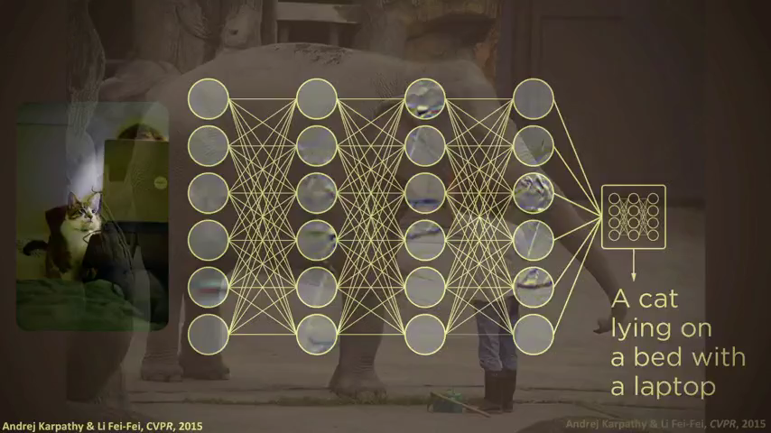
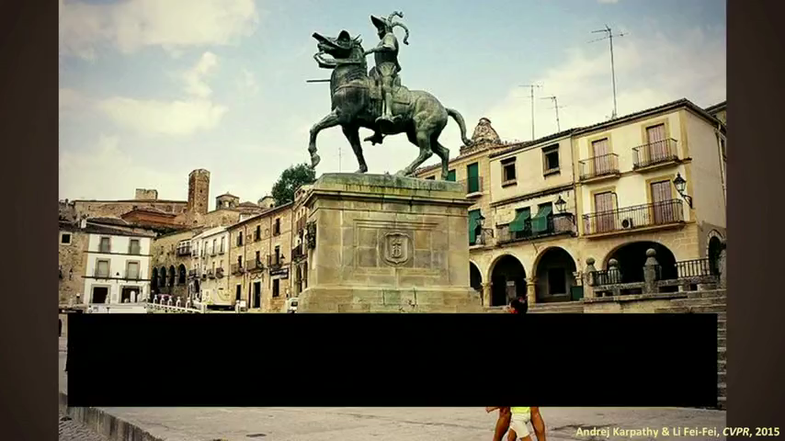

Motivation
Humans are experts on recognizing objects and events in the world.
We have taught machines how to perform as closest human-like learning as we know at the moment.
Notes:
Motivation relies on the fact that humans are experts on performing many tasks they have learned to do.
Reviewing the growth of AI during the last century, one can note that machines has achieved to do complex things like this one (video1).
Which involve not only to understand objects and scenes from images but also to describe them.
Of course, computers still make some mistakes like here. So you can imagine the complexity or such tasks as describing art or sculptures, even though machines are able to recognize them already.
But what is important is that we have a better understanding of human learning so as to be able to teach machines for doing these tasks in a similar way we know we perform them. And these achievements involve multidisciplinary research such as CV, ML, NLP.
These tasks imply the analysis of many content: images, objects, scene, interactions… that are present in many domains.

Slide 3
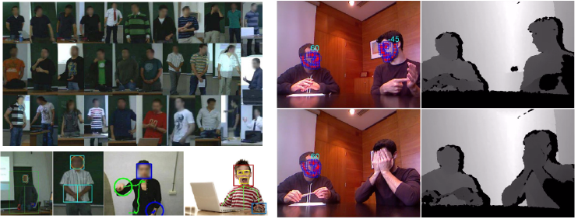
Motivation
Abstraction to human behavioural cues
from multimodal data description.
Hypothesis: Language is misconstrued if it is not seen as a unity of speech and gesture.
D. McNeill (2012). How Language Began: Gesture and Speech in Human Evolution. Cambridge University Press.
Notes:
One of these complex domains of interest is the analysis of humans, where one can build systems able to abstract mid level representations referred to human behaviour that is present in different domains under the hypothesis of that Language […]
- This provide a way of interpreting multiple content coming form different contexts where humans appear.
- Due the importance of these analyses, in this thesis we particularly exploit and propose methods paying special attention to the field of gesture and action recognition. Here are some examples with different contexts and analyses where to apply these feature extraction techniques. But, how is the feature extraction process done?
- (Considering the observational methodology of non-verbal language, the assumption is that we can use computers for capturing information that we, as humans, cannot pay full attention consciously, but that are actually crucial for a conversation process. In addition, the underlying hypothesis is that […]).

Slide 4

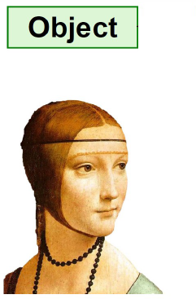
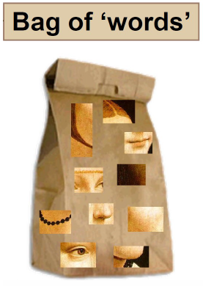
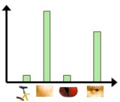
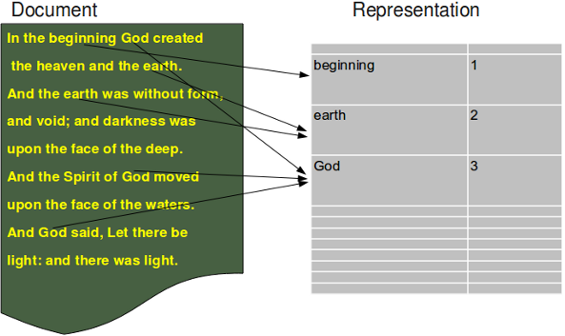
Motivation
The composition of parts is what forms the whole object.
http://vision.stanford.edu
http://www.python-course.eu
Notes:
Of course there are a lot of variants and representations we can find by exploring these problems in computer vision, but many of them can converge into one of the common paradigms for representing objects, which comes from text mining in documents, and is the so-called Bag of Words.
Where the key idea is that if we combine the parts of an object we form the whole object, in this case a face.
So we can create an histogram for counting the frequency of occurence of each part, in a similar way it is done for representing documents or images.

Slide 5
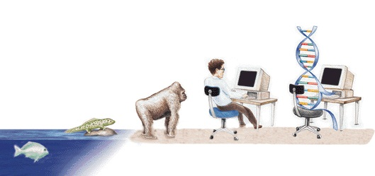
Motivation
Evolving BoW representations.
Biologically inspired.
Highly domain-adaptive.
Parallel processing.
http://mleg.cse.sc.edu
Notes:
Also, from the side of evolutionary computation, the hypothesis is that evolving BoW representations benefits for improving their performance in several domains.
The reason and advantages of using EC are mainly that they’re often inspired in biological mechanisms of evolution, they perform well approximating solutions to all types of problems, metaheuristic search uses parallel processing to achieve the desired end.
In this sense, the aim of this thesis is to study different techniques underlying these paradigms with different goals:

Slide 6
Goals
G1: Define BoVW-weighting schemes representations of objects in data by means of genetic programming (GP) optimization.
G2: Learn multimodal BoVW for recognizing gestures.
G3: Gesture detection through dynamic programming and generative models.
G4: Learning Bag of Sub-Gestures via evolutionary computation.
Notes:
One of the goals, which is claimed by many scientists in thesis, is the integration of BoVW paradigm into several frameworks or architectures. And EA are one of them that we explore, assuming that we can optimize such representations over time by means of GP frameworks.
Be able to learn data coming from multiple modalities for tasks such as gesture recognition.
Build frameworks for gesture detection through DP and GM computational models.
Finally, to learn and evolve Subgesture representations by means of evolutionary algorithms.

Slide 7

Notes:
So the outline of this presentations follows the structure for the different chapters of this thesis

Slide 8
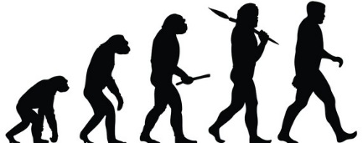
Evolved
Visual
Evolving Visual
Representations
Notes:
In the first part, I’ll present our evolutionary computation approach for learning visual representations in images.

Slide 9
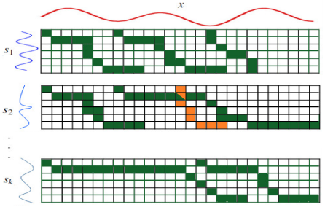
Evolved
Visual
Spatio
Temporal
Learning
Spatio-Temporal
Representations
Notes:
In the second part, I’ll present extensions of classical approaches commonly used in multimodal gesture recognition, so as to learn spatio-temporal representations

Slide 10
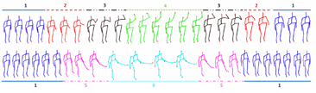
Evolved
Visual
Spatio
Temporal
Evolved
Dynamic
Evolving Dynamic
Representations
Notes:
Then, in the third part, I’ll introduce a novel approach for evolving representations based on dynamic programming and generative models for action recognition.

Slide 11
Evolved
Visual
Spatio
Temporal
Evolved
Dynamic
Conclusion
Conclusions
Notes:
Finally, in the last part I’ll expain an application case of an interdisciplinary approach we dealt for analyzing real conversations in a very particular context, learning behavioral cues abstracted from multimodal descriptors.

Slide 12
Evolved
Visual
Spatio
Temporal
Evolved
Dynamic
Conclusion
State of the Art
Evolving Visual
Representations
Learning
Spatio-Temporal
Representations
Evolving Dynamic
Representations
Conclusions
Notes:
These are the parts of the thesis, and I’ll start with the state of the art covering the key aspects of all parts, from static to dynamic approaches and, finally, the literature related to our application case.

Slide 13
Evolved
Visual
Spatio
Temporal
Evolved
Dynamic
Conclusion
Evolving Visual Representations
Notes:
So let's now focus on the first part of Evolving Visual Representations. (gluc?)

Slide 14
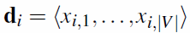
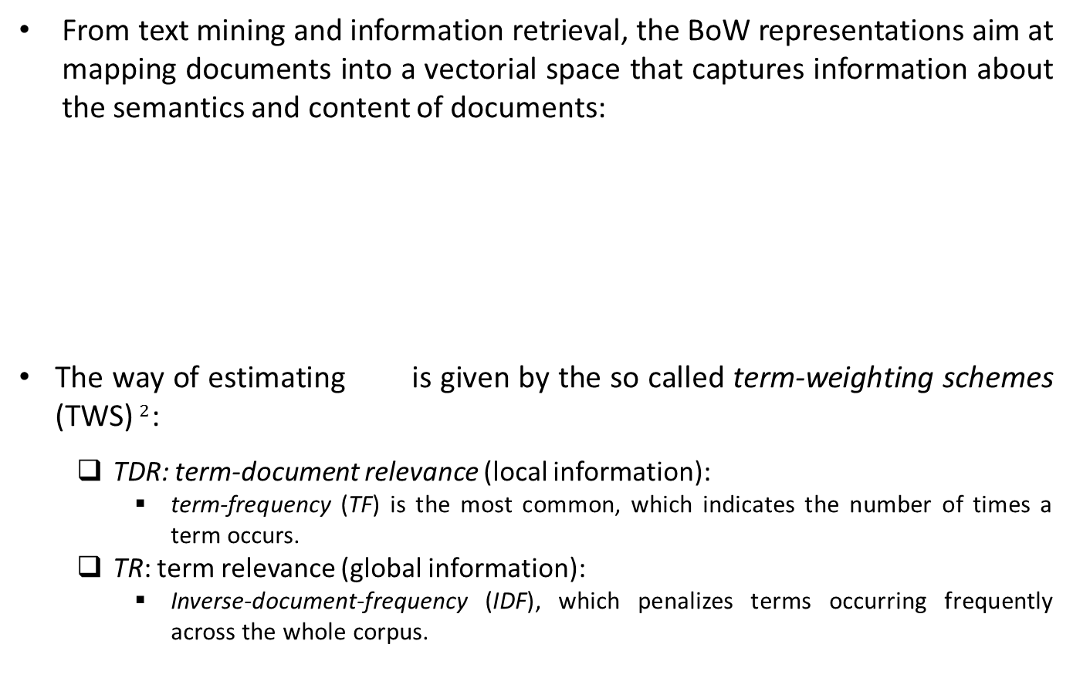
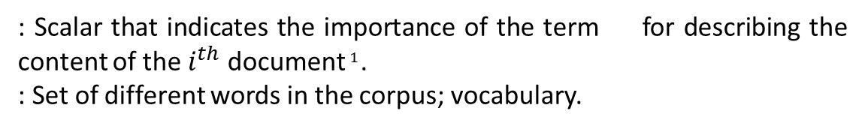
Evolved
Visual
Spatio
Temporal
Evolved
Dynamic
Conclusion
Term-Weighting Schemes
From text mining and information retrieval, the BoW representations aim at mapping documents into a vectorial space that captures information about the semantics and content of documents:
The way of estimating is given by the so called term-weighting schemes (TWS)$^{2}$:
TDR: term-document relevance (local information):
term-frequency (TF) is the most common, which indicates the number of times a term occurs.
TR: term relevance (global information):
Inverse-document-frequency (IDF), which penalizes terms occurring frequently across the whole corpus.
: Scalar that indicates the importance of the term for describing the content of the $i^{th}$ document$^{1}$.
: Set of different words in the corpus; vocabulary.
[1] Sivic, J. and Zisserman, A. (2003). Video google: A text retrieval approach to object matching in videos. In ICCV, volume 2, pages 1470–1477.
[2] Debole, F. and Sebastiani, F. (2003). Supervised term-weighting for automated text categorization. In SAC, pages 784–788, New York, NY, USA. ACM.
Notes:
Going towards the Bag of Visual Words, one have to explore from […]
Each document is represented using the frequency of appearance of each word in a dictionary.
This is one of the most common representations nowadays, though there a lot of variants on both the way to obtain x_{i,j} and to alleviate the effects of taking strong assumptions on the importance of the order of words.
The features of the document are estimated by means of term-weighting schemes.
Most common are TDR and TR, which consider local information and global information, respectively. What usually people do is to combine them,
and the most common combination is term-frequency and inverse-document-frequency. However, this is not the best choice in supervised learning because traditional schemes were originally proposed for unsupervised problems.

Slide 15
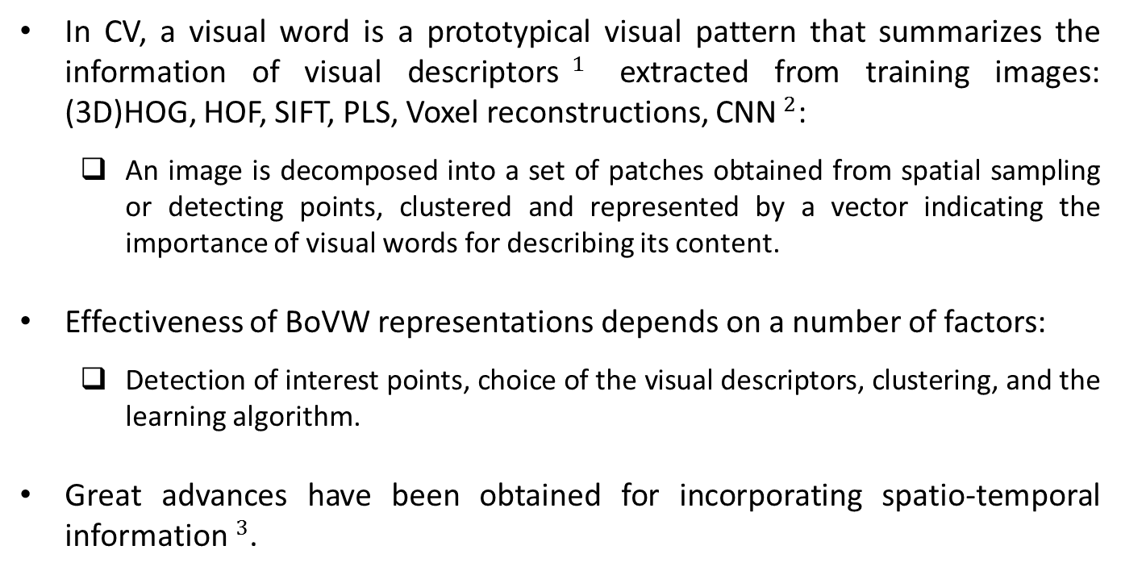
Evolved
Visual
Spatio
Temporal
Evolved
Dynamic
Conclusion
Towards BoVW
In CV, a visual word is a prototypical visual pattern that summarizes the information of visual descriptors$^{1}$ extracted from training images: (3D)HOG, HOF, SIFT, PLS, Voxel reconstructions, CNN$^{2}$:
An image is decomposed into a set of patches obtained from spatial sampling or detecting points, clustered and represented by a vector indicating the importance of visual words for describing its content.
Effectiveness of BoVW representations depends on a number of factors:
Detection of interest points, choice of the visual descriptors, clustering, and the learning algorithm.
Great advances have been obtained for incorporating spatio-temporal information$^{3}$.
[1] Zhang, J., Marszablek, M., Lazebnik, S., and Schmid, C. (2007). Local features and kernels for classification of texture and object categories: A comprehensive study. IJCV, 73(2):213–238.
[2] E. Simo-Serra, E. Trulls, L. Ferraz, I. Kokkinos, P. Fua, and F. Moreno-Noguer. Discriminative Learning of Deep Convolutional Feature Point Descriptors. ICCV 2015.
[3] Laptev, I., Marszalek, M., Schmid, C., and Rozenfeld, B. (2008). Learning realistic human actions from movies. In CVPR, pages 1–8.
Notes:
How does it work in CV? The word become a prototypical visual pattern simplified from the original visual descriptors. Here I mention a few.
The general process is to decompose images by means of grids, sliding windows, detection of corners, or salient regions. Then, clustering of these descriptions to obtain a histogram that accounts for the occurrences of visual words in the image.
So what is crucial to success on the selection of proper bag of visual words representations? It depends on different aspects such as […] where to model our chosen representation.
Actually, including spatio-temporal information into these representations leads to better performance in several domains, such as learning human actions.

Slide 16
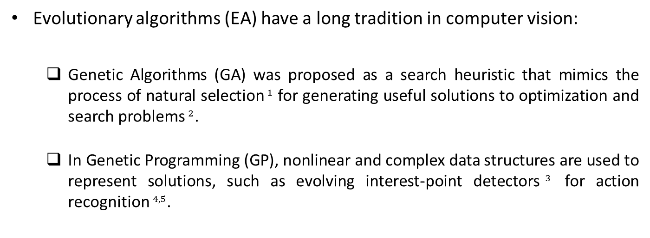
Evolved
Visual
Spatio
Temporal
Evolved
Dynamic
Conclusion
Evolutionary Computation
Evolutionary algorithms (EA) have a long tradition in computer vision:
Genetic Algorithms (GA) was proposed as a search heuristic that mimics the process of natural selection$^{1}$ for generating useful solutions to optimization and search problems$^{2}$.
In Genetic Programming (GP), nonlinear and complex data structures are used to represent solutions, such as evolving interest-point detectors$^{3}$ for action recognition$^{4,5}$.
[1] J. H. Holland. University of Michigan Press, Ann Arbor. 1975. Adaptation in Natural and Artificial Systems.
[2] D. E. Goldberg. Genetic Algorithms in Search, Optimization and Machine Learning. Addison-Wesley Longman Publishing Co., Inc., Boston, MA, USA. 1989.
[3] Trujillo, L. and Olague, G. (2006). Synthesis of interest point detectors through genetic programming. In GECCO, pages 887–894, New York, NY, USA. ACM.
[4] Liu, L. and Shao, L. (2013). Learning discriminative representations from rgb-d data. In IJCAI.
[5] Liu, L., Shao, L., and Rockett, P. (2012). Genetic programming-evolved spatio-temporal descriptor for human action recognition. In BMVC, pages 18.1–18.12.
Notes:
On the other hand EA has been widely used in the literature of CV.
In particular, we refer to GA, whose purpose was very promising in artificial intelligence as a search heuristic […]
Then, GP are used to learn and evolve […] for obtaining richer BoVW representations. It has been applied to several domains such as action recognition by means of evolving interest-point detectors.

Slide 17
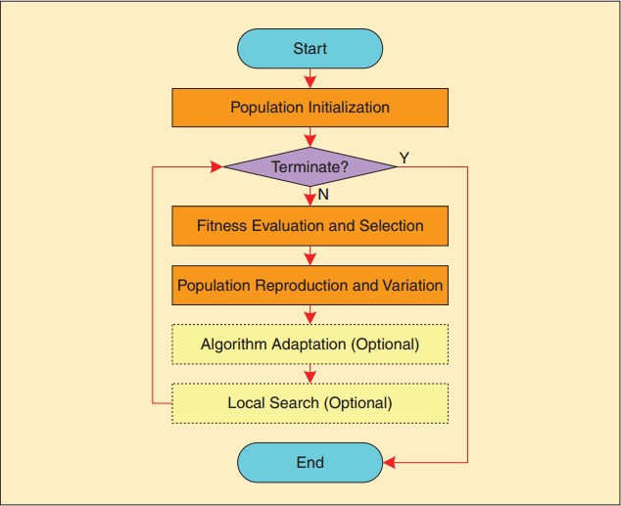
Evolved
Visual
Spatio
Temporal
Evolved
Dynamic
Conclusion
Evolutionary Computation
[1] J. Zhang, Z.-H. Zhan, Y. Lin, N. Chen, Y.-J. Gong, J.-H. Zhong, H.-S.-H. Chung, Y. Li, and Y.-H. Shi. (2011). Evolutionary Computation Meets Machine Learning: A Survey. IEEE Computational Intelligence Magazine, vol. 6, nº 4, pp. 68-75.
Notes:
General flow diagram for an evolutionary computation framework.
1) Initial step of initialization of individuals of the population, usually an stochastic process.
2) Then we have the main loop, where as the terminating conditions are not satisfied, the population is evaluated, selected, reproduced or varied, and the parameters are adapted to our method, as well as the structures where to perform the search.

Slide 18
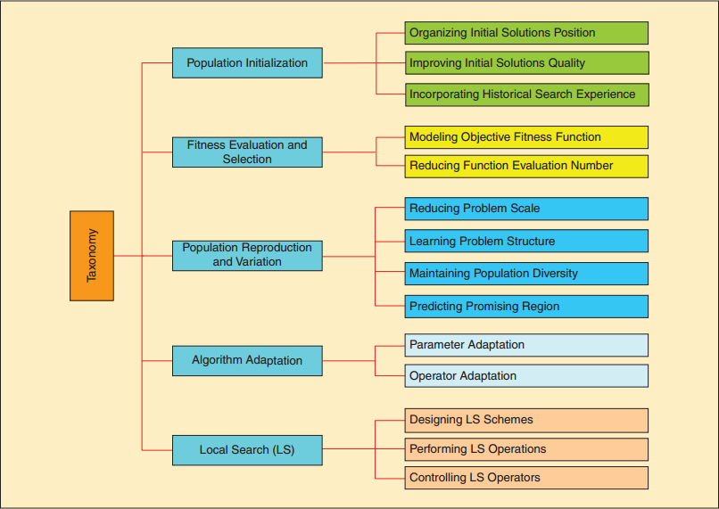
Evolved
Visual
Spatio
Temporal
Evolved
Dynamic
Conclusion
Evolutionary Computation
[1] J. Zhang, Z.-H. Zhan, Y. Lin, N. Chen, Y.-J. Gong, J.-H. Zhong, H.-S.-H. Chung, Y. Li, and Y.-H. Shi. (2011). Evolutionary Computation Meets Machine Learning: A Survey. IEEE Computational Intelligence Magazine, vol. 6, nº 4, pp. 68-75.
Notes:
Going deeper into the taxonomy of the framework, we can see the main criteria which are taken at each step.
In practice, probably the most common ones are: Organizing…, Modelling…, Predicting regions to focalize the search, and usually update parameters and save the model structures. For example, to consider the next generation of offsprings.

Slide 19
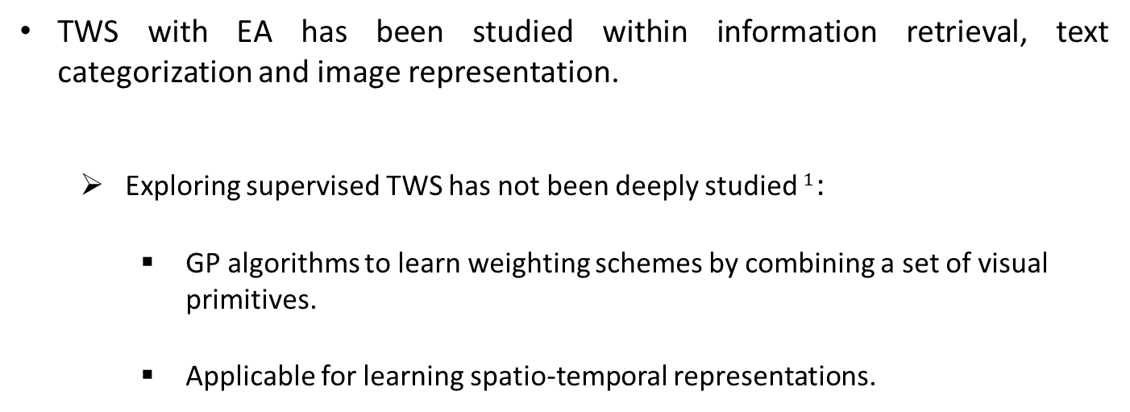
Evolved
Visual
Spatio
Temporal
Evolved
Dynamic
Conclusion
Evolving TWS
TWS with EA has been studied within information retrieval, text categorization and image representation.
Exploring supervised TWS has not been deeply studied$^{1}$:
GP algorithms to learn weighting schemes by combining a set of visual primitives.
Applicable for learning spatio-temporal representations.
[1] Tirilly, P., Claveau, V., and Gros, P. (2009). A review of weigthing schemes for bag of visual words image retrieval. Technical report, IRISA.
Notes:
The learning of evolved term-weighting schemes have been also explored in IR, text categorization, and weakly for image representations.
However, it still remains unknown how good can be the role of TWS in different domains.
In particular, whether the combination of a set of visual primitives can evolve TWS by means of GP.
And also whether TWS are capable of learning spatio-temporal representations.

Slide 20
Evolved
Visual
Spatio
Temporal
Evolved
Dynamic
Conclusion
EA for BoVW
BoVW is a widely adopted representation for describing the content of images and videos in computer vision problems:
Standard weighting schemes based on term frequency are effective and popular:
Histogram that accounts for the occurrences of visual words.
Explore the suitability of alternative TWS for image and video representation.
Propose an EA capable of automatically learning TWS:
Explore the search space of possible TWS that can be generated by combining a set of primitives with the aim of maximizing the classification/recognition performance:
Image categorization.
Adult image classification.
Insect and bird classification.
Places-scene recognition.
Gesture and action recognition.
Notes:
As we have explained before, […].
So that standard […], And the most common representation consists of a histogram […]
Thus, it it is worth exploring […].
More importantly, we focus on EA that are able to […]. This is to perform an exhaustive exploration of the search […].
Here is a list of the particular tasks we address: […]

Slide 21
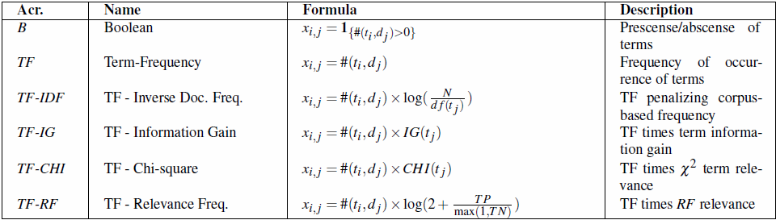

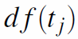
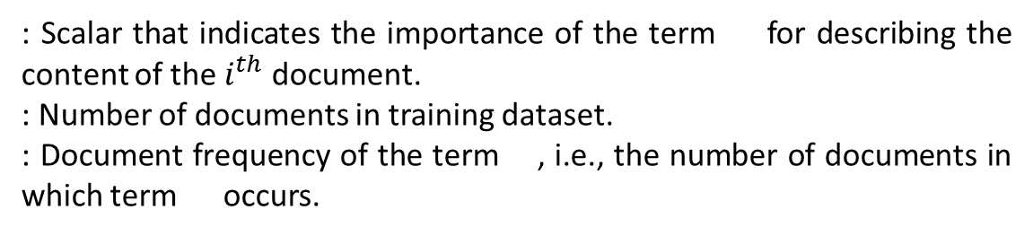
Evolved
Visual
Spatio
Temporal
Evolved
Dynamic
Conclusion
Weighting Schemes
Weighting schemes used in text mining and information retrieval:
: Scalar that indicates the importance of the term for describing the content of the $i^{th}$ document.
: Number of documents in training dataset.
: Document frequency of the term , i.e., the number of documents in which term occurs.
[1] Salton, G. and Buckley, C. (1988). Term-weighting approaches in automatic text retrieval. Inform. Process. Manag., pages 513–523.
[2] Debole, F. and Sebastiani, F. (2003). Supervised term-weighting for automated text categorization. In Proceedings of the 2003 ACM Symposium on Applied Computing, SAC ’03, pages 784–788, New York, NY, USA. ACM.
[3] Lan, M., Tan, C. L., Su, J., and Lu, Y. (2009). Supervised and traditional term-weighting methods for automatic text categorization. In TPAMI, 31(4):721–735.
Notes:
About the weighting schemes, in this table we can see a list of those used in text mining and IR.
I am not going to explain all of them, but one of the most common, which is the term-frequency times the inverse-document frequency, Basically, it describes the term-frequencies penalizing corpus-based frequency under this formula here.
Just a remaining of the nomenclature, where #(d_i,t_j) indicates the frequency of the term in a document and d_f(t_f) the number of […] form the total number of training documents in the dataset.
Note that these alternatives aim at incorporating discriminative information into the representation by defining TR weights (second column here) that account for the discriminative power of terms.

Slide 22
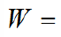
Evolved
Visual
Spatio
Temporal
Evolved
Dynamic
Conclusion
GP for learning TWS
Automatically design weighting schemes by means of EA:
Use Genetic Programming to learn how to combine a set of TR/TDR primitives for every dataset in order to optimize classification performance.
Function set
Notes:
The next stage is to design weighting schemes through EA, and in particular GP, whose common representations of individuals within a pouplation are encoded as trees or graphs. For this purpose a GP will learn how to […], providing natural solutions, aiming at optimizing…].
This is the general diagram of the proposed approach. A set of primitives is extracted from the BoVW representation of training images, obtained by counting visual word occurrences. Next, they are feed into a genetic program that learns how to combine such primitives to generate a term-weighting scheme. The output of the genetic program is a way to represent images that has been learned automatically. Next, both training and test images are represented according to the learned scheme and, finally, a predictive model is learned and their performance evaluated.
If we focus on the tree structure adopted for representing the individuals, leafs correspond to primitives and non-terminal nodes correspond to operators by which primitives can be combined; in such a way that the evaluation of a tree leads to a term-weighting scheme. Dashed nodes represent operators (from the function set) and solid-line nodes indicate terminals; below the tree we show the term-weighting scheme derived from it, which includes common/alternative weighting schemes in the search space of possible solutions (individuals).

Slide 23
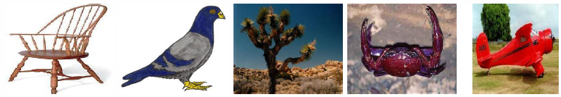
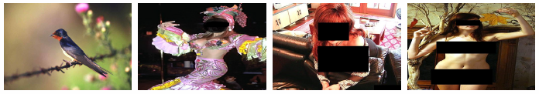
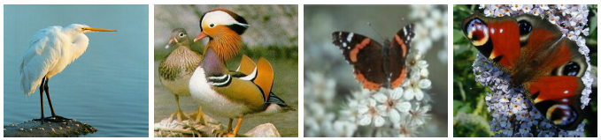
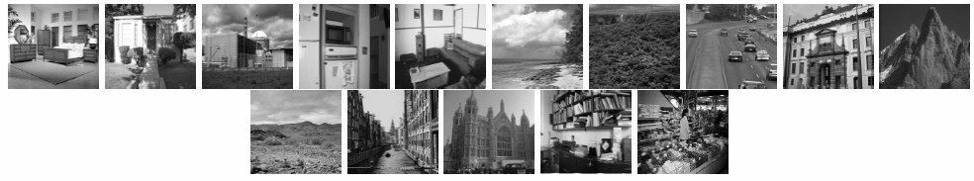
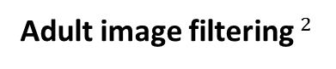


Evolved
Visual
Spatio
Temporal
Evolved
Dynamic
Conclusion
Data - still images
Caltech-101$^{1}$
Adult image filtering$^{2}$
Birds and butterflies
Scene recognition$^{3}$
[1] Fei-Fei, L., Fergus, R., and Perona, P. (2004). Learning generative visual models from few training examples: an incremental bayesian approach tested on 101 object categories.In IEEE Proc. CVPRW.
[2] Deselaers, T., Pimenidis, L., and Ney, H. (2008). Bag of visual words for adult image classification and filtering. In ICPR.
[3] Lazebnik, S., Schmid, C., and Ponce, J. (2006). Beyond bags of features: Spatial pyramid matching for recognizing natural scene categories. In CVIP, pages 2169–2178.
Notes:
Here are some examples of these common datasets used for categorization or classification of still images. Caltech-101, Adult image filtering, Birds and butterflies and Scene recognition.

Slide 24
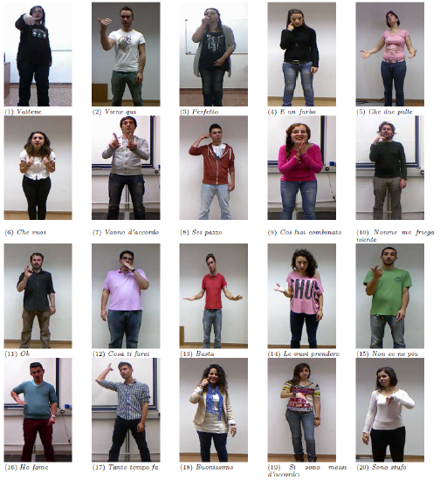
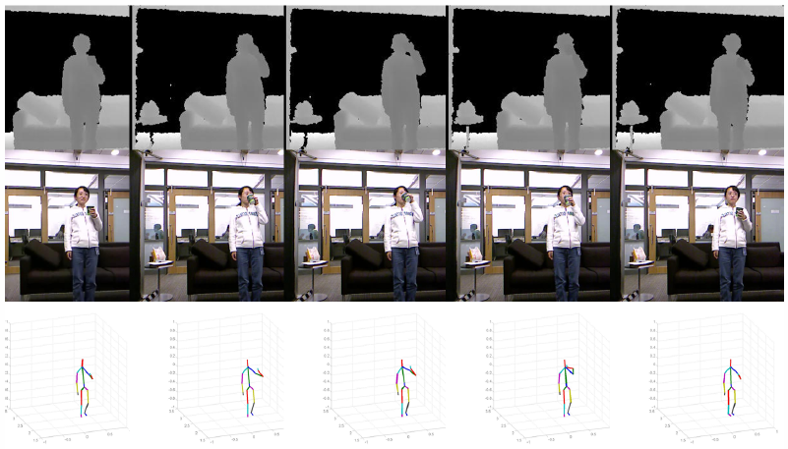


Evolved
Visual
Spatio
Temporal
Evolved
Dynamic
Conclusion
Data - sequences
Montalbano$^{1}$
MSRDaily3D$^{2}$
[1] Escalera, S., Baró, X., Gonzalez, J., Bautista, M. A., Madadi, M., Reyes, M., Ponce-López, V., Escalante, H. J., Shotton, J., and Guyon, I. (2014). ChaLearn looking at people challenge 2014: Dataset and results. In ECCVW.
[2] Wang, J., Liu, Z., Wu, Y., and Yuan, J. (2012). Mining actionlet ensemble for action recognition with depth cameras. In CVPR, pages 1290–1297.
Notes:
Here are some examples of the Montalbano and Microsoft Daily 3D datasets for recognizing sequence cateogiries.

Slide 25
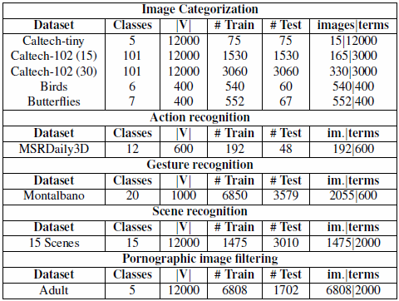
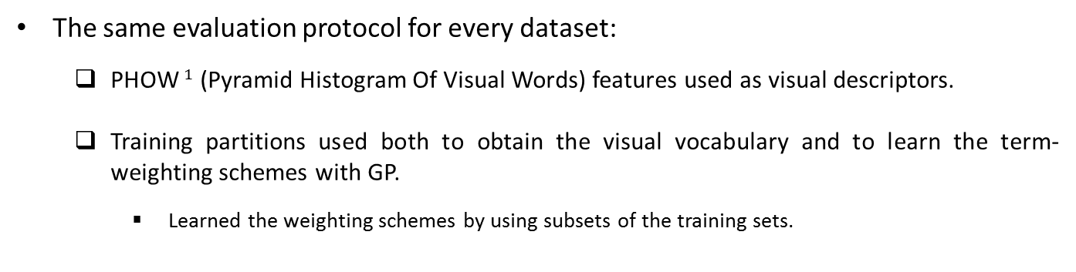
Evolved
Visual
Spatio
Temporal
Evolved
Dynamic
Conclusion
Experimental settings
The same evaluation protocol for every dataset:
PHOW$^{1}$ (Pyramid Histogram Of Visual Words) features used as visual descriptors.
Training partitions used both to obtain the visual vocabulary and to learn the term-weighting schemes with GP.
Learned the weighting schemes by using subsets of the training sets.
[1] Bosch, A., Zisserman, A., and Munoz, X. (2007). Image classifcation using random forests and ferns. In ICCV.
Notes:
Then, for the experimental settings we used the same evaluation for every dataset:
The visual descriptors computed from the videos are the Pyramid […] from the VLFEAT toolbox.
[…]
These are the different datasets used and some brief info about them, where we can see that not all the terms of the vocabulary that define each class are used in traning.

Slide 26
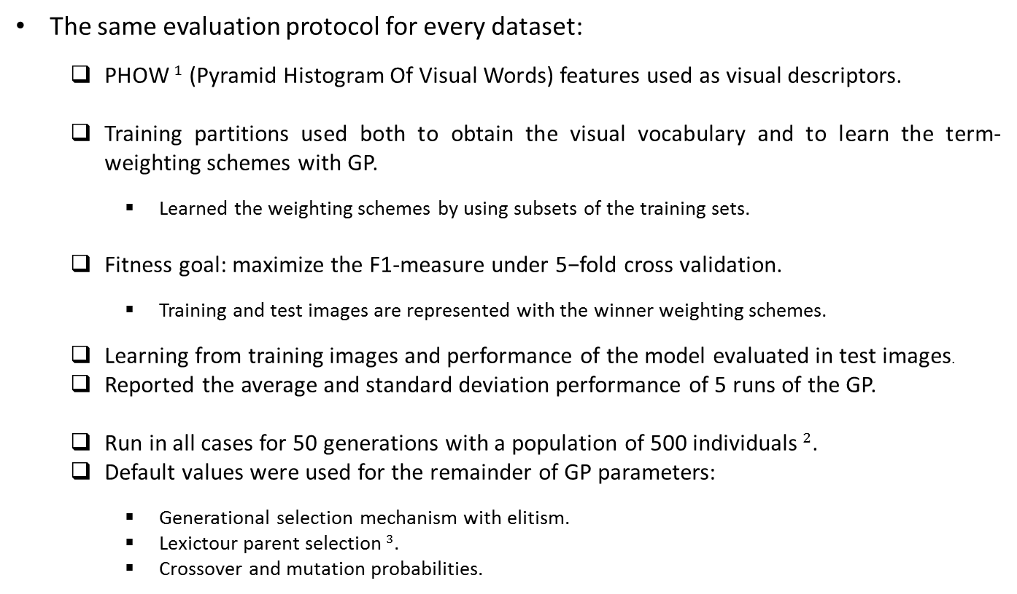
Evolved
Visual
Spatio
Temporal
Evolved
Dynamic
Conclusion
Experimental settings
The same evaluation protocol for every dataset:
PHOW$^{1}$ (Pyramid Histogram Of Visual Words) features used as visual descriptors.
Training partitions used both to obtain the visual vocabulary and to learn the term-weighting schemes with GP.
Learned the weighting schemes by using subsets of the training sets.
Fitness goal: maximize the F1-measure under 5−fold cross validation.
Training and test images are represented with the winner weighting schemes.
Learning from training images and performance of the model evaluated in test images.
Reported the average and standard deviation performance of 5 runs of the GP.
Run in all cases for 50 generations with a population of 500 individuals$^{2}$.
Default values were used for the remainder of GP parameters:
Generational selection mechanism with elitism.
Lexictour parent selection$^{3}$.
Crossover and mutation probabilities.
[1] Bosch, A., Zisserman, A., and Munoz, X. (2007). Image classifcation using random forests and ferns. In ICCV.
[2] Langdon, W. B. and Poli, R. (2001). Foundations of Genetic Programming. Springer.
[3] Luke, S. and Panait, L. (2002). Lexicographic parsimony pressure. In Proceedings of GECCO, pages 829–836.
Notes:
Then, the fitness goal is to […]
Learning from […]
For the default parameters of the GP […] (the parent selection consist of controlling the significant growth of genetic programming trees during the course of an evolutionary computation run. Lexicographic parsimony pressure modifies selection to prefer smaller trees only when fitnesses are equal (or equal in rank)).

Slide 27
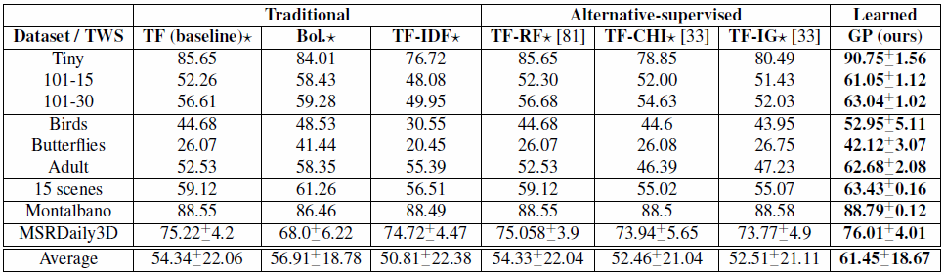
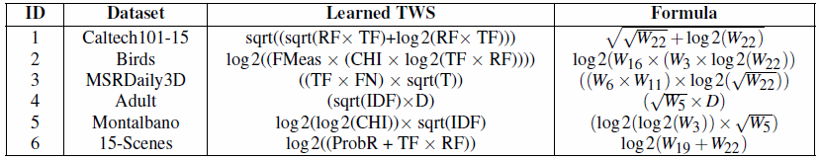
Evolved
Visual
Spatio
Temporal
Evolved
Dynamic
Conclusion
Results
Results obtained by the different weighting schemes (traditional, alternative-supervised and learned) in all of the considered datasets:
Average f1−measure performance in the test partitions.
Notes:
These are the results for all the datasets obtained by averaging the f1 measure in the test partitions amongst the runs of the GP.
We can see that for all these datasets, learning the weighting schemes with GP gives a considerable better performance with respect to traditional and alternative weighting schemes. Also we provide the mathematical expressions of the learned TWS for every dataset, which correspond to the terminal set and the operators of the function set.
Standard descriptors were used for the datasets of still images. Specially the higher improvements are for the adult filtering dataset.
In particular, for Montalbano and MSRDaily the descriptors are themselves quite discriminative so that the improvement is marginal.

Slide 28
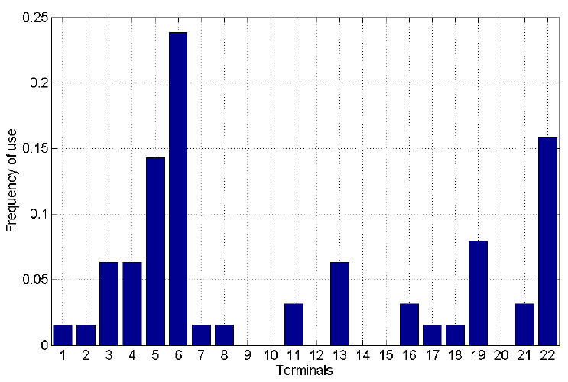
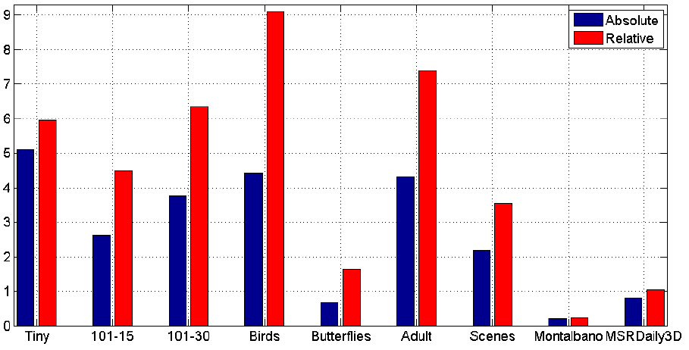
Evolved
Visual
Spatio
Temporal
Evolved
Dynamic
Conclusion
Results
Range of improvement of the proposed method over the best traditional/alternative weighting scheme per dataset in terms of absolute and relative differences.
Frequency of appearance of terminals into the solutions found by the GP.
Absolute and relative improvements for the different datasets, taking as reference the best traditional/alternative weighting scheme for each dataset.
Scores
Dataset
Notes:
Additionally, to see a qualitative analysis of the range of improvement, we show the absolute and relative […]. We can observe clearly the little improvement of the sequence categorization datasets wrt to image categorization.
And, here a frequency of appearance of terminals for the GP given solutions. What is interesting is that even when these were the most chosen terminals by solutions returned with the GO, such terminals were significantly outperformed by the final learned TWS.

Slide 29
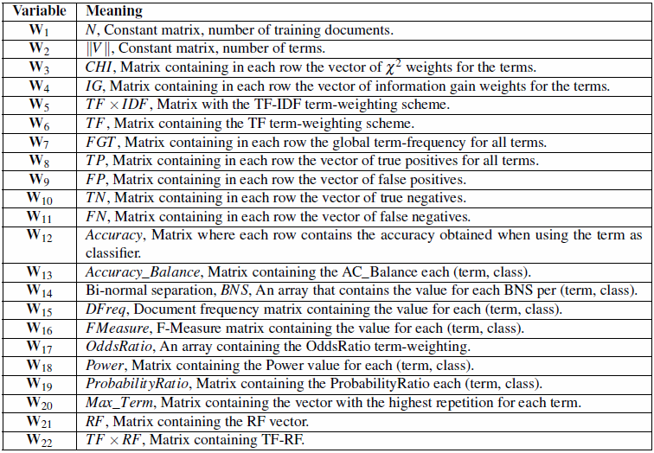
Evolved
Visual
Spatio
Temporal
Evolved
Dynamic
Conclusion
GP for learning TWS
Terminal set Representation
Notes:
This is the table with the terminal set from which weighting schemes can be obtained by the GP solutions. The weighting scheme chosen as the solution for the current generation is the one that maximize the classification performance given by the fitness function, where training documents are represented by the different weighting schemes determined from the individuals, and then k-fold cross validation is performed, employing SVM as the machine learning technique.
Standard genetic operators are used. Crossover consists of swapping subtrees between parents that are below the randomly chosen nodes. For mutation, a node from the parent is identified and randomly replaced by another node.

Slide 30
Evolved
Visual
Spatio
Temporal
Evolved
Dynamic
Conclusion
Learning Spatio-temporal
Representations
Notes:
Ok, so once an evolution of learning visual representations is presented, let’s start with the next part about learning […].

Slide 31
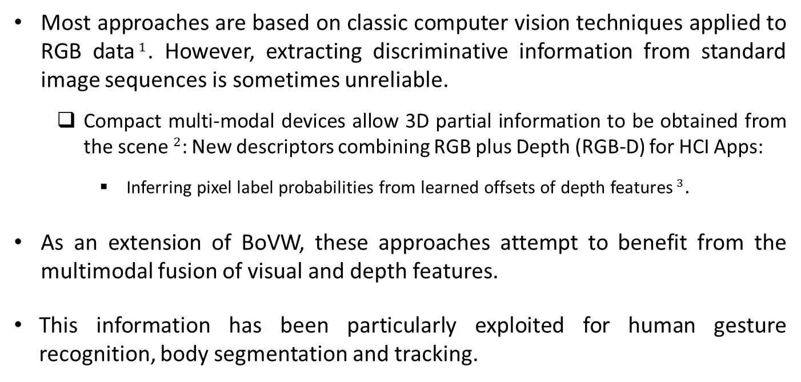
Evolved
Visual
Spatio
Temporal
Evolved
Dynamic
Conclusion
Multimodal representations
Most approaches are based on classic computer vision techniques applied to RGB data$^{1}$. However, extracting discriminative information from standard image sequences is sometimes unreliable.
Compact multi-modal devices allow 3D partial information to be obtained from the scene$^{2}$: New descriptors combining RGB plus Depth (RGB-D) for HCI Apps:
Inferring pixel label probabilities from learned offsets of depth features$^{3}$.
As an extension of BoVW, these approaches attempt to benefit from the multimodal fusion of visual and depth features.
This information has been particularly exploited for human gesture recognition, body segmentation and tracking.
[1] Tirilly, P., Claveau, V., and Gros, P. (2009). A review of weigthing schemes for bag of visual words image retrieval. Technical report, IRISA.
[2] HD. Yang, S. L. (2007). Reconstruction of 3d human body pose from stereo image sequences based on top-down learning. Pattern Recognition, 40(11):3120–3131.
[3] Shotton, J. et al. (2011). Real-time human pose recognition in parts from single depth images. In CVPR, pages 1297–1304.
Notes:
Going back on how do we obtain representations based on BoVW one should consider that [...]. The problem is that the feature extraction process in a large number of imatges is sometimes expensive in terms of computation.
In this sense, some compact devices allow to capture synchronized information of different modalities so as to obtain a new richer dimension from the scene such as the depth. New descriptors emerge, and the idea of […] has become crucial in many HCI applications.
In particular, exploring the multimodal fusion of these features attempts to provide additional benefits on learning richer representations for gesture recognition.
This information […]

Slide 32
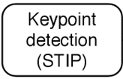
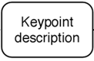
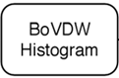
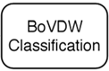
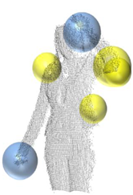
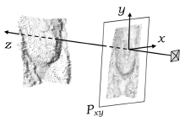
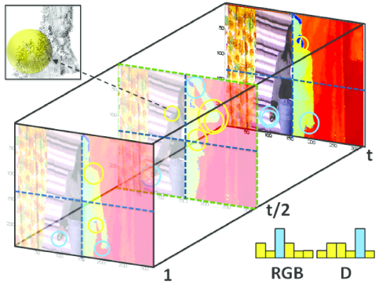
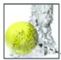
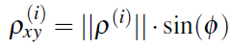
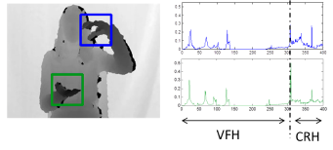
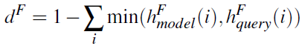

Evolved
Visual
Spatio
Temporal
Evolved
Dynamic
Conclusion
Gesture Representation
BoVDW approach: Merging RGB + Depth information by means of late fusion.
Viewpoint Feature Histogram and Camera Roll Histogram
[1] Laptev, I. (2005). On space-time interest points. In IJCV, 64(2-3):107–123.
[2] Dalal, N. and Triggs, B. (2005). Histograms of oriented gradients for human detection. CVPR, 2:886–893.
[3] Laptev, I., Marszalek, M., Schmid, C., and Rozenfeld, B. (2008). Learning realistic human actions from movies. In CVPR, pp. 1–8.
[4] Rusu, R., Bradski, G., Thibaux, R., and Hsu, J. (2010). Fast 3d recognition and pose using the viewpoint feature histogram. In IROS, pp. 2155 –2162.
Notes:
Thus, here we propose a gesture representation based on BoVDW,
the first step consists of selecting a set of points in the images with relevant properties, in this case we use the well-known STIP descriptor as the extension of the Harris detector in the temporal dimension, separately in RGB and Depth volumes.
Next, the description of points detected, using several approaches such as oriented gradients or optical flow.
In particular this approach uses a combination of two descriptors: view feature histogram and camera roll histogram. First describing the whole point cloud using VFH, which is variant to object rotation around pitch and yaw axis, but invariant to the roll axis of the camera. Then, CRH that computes the orthographic projection of the point cloud onto a plane that is orthogonal to the roll axis.
The vocabulary of visual and depth words is constructed using k-means clustering over each video query, from which we obtain the histogram of word occurrences. Then, spatiotemporal pyramids are applied to add geometrical and temporal information, dividing the video volume into separate bins that are computed with the points lying in each volume dimension and concatenating them with the general histogram.
In this case classification consists of a late fusion approach from the histograms belonging to each RGB and depth modalities separately using kNN, using the complementary of the histogram intersection as the distance.
The final distance between histograms for each modality is computed by means of a weighted sum of distances.
Entonces, métodos para reconocer.

Slide 33









Evolved
Visual
Spatio
Temporal
Evolved
Dynamic
Conclusion
Probabilistic Dynamic
Programming
In the context of gesture recognition, it is common the use of methods based on dynamic programming, which breaks down a complex problem into a collection of simpler sub-problems.
s.t.
Generative models allow to deal with the high variability due to environmental conditions among different domains:
Wide range of human pose configurations, influence of background, continuity of human movements, spontaneity of human actions, speed, appearance of unexpected objects, illumination changes, partial/self occlusions, different points of view…
[1] Parizeau, M. and Plamondon, R. (1990). A comparative analysis of regional correlation, dynamic time warping, and skeletal tree matching for signature verification. IEEE TPAMI, 12(7).
[2] Reyes, M., Dominguez, G., and Escalera, S. (2011). Feature weighting in dynamic time warping for gesture recognition in depth data. ICCV Workshops, pp. 1182–1188.
[3] Zhou, F., De la Torre Frade, F., and Hodgins , J. K. (2013). Hierarchical aligned cluster analysis for temporal clustering of human motion. IEEE TPAMI, 35(3):582–596.
Notes:
On the other hand, a common idea used in the context of gesture recognition […]
To divide a complex problem into a collection of simpler subproblems, which can be done efficiently with DP. In particular one of the most common methods used in the literature is DTW. However, this idea differs depending on whether the goal is to align or to detect sequences.
For the general procedure, a matrix is computed by accumulating the distances amongst all element of the sequences,
Then a warping path of minimum distances is constructed, whose last element value defines the cost of DTW. This is given as the result of aligning the two sequences.
In case of detecting similar sequences within a very large sequence, the idea is to find a warping path whose cost is below that a given threshold.
This is the same idea, but a backtracking algorithm starting from the last position is needed here (instead of the way done in the formula) so as to define the proper warping path.
On the other hand, Generative or Probabilistic models embedded into these type DP frameworks in order to allow to handle with the high intra-class variability of sequences cause, which are due to the […]. Just to mention a few, some of these complex conditions are […].

Slide 34


Evolved
Visual
Spatio
Temporal
Evolved
Dynamic
Conclusion
Gesture Segmentation
Probabilistic-based Dynamic Time Warping algorithm
Notes:
In more detail about this process, here is the algorithm for the PDTW. Just remark that at the initilization the DTW cost matrix is assigned to infinity, except the first row in case of detecting sequences rather than aligning sequences, which is assigned to 0.
Then, the elements of the cost matrix are accumulated using the soft-distance measure, so that if the last cost for the current element (or frame) is below the given threshold then we compute the warping path by means of backtracking the costs. Otherwise, we follow the process from the next element (or frame).
In this case we follow this approach considering a single warping path, but multiple paths might be also detected.

Slide 35

Evolved
Visual
Spatio
Temporal
Evolved
Dynamic
Conclusion
Generative Models
Especially used in temporal pattern recognition:
Assume unobservable state variables that are inferred from observations$^{1}$.
Infer about the properties of sub-populations given only observations on the pooled population, without sub-population identity information$^{2}$.
Learn a probability distribution over a set of inputs from a stochastic artificial neural network${ }^{3}$.
High variability due to environmental conditions among different domains:
Wide range of human pose configurations, influence of background, continuity of human movements, spontaneity of human actions, speed, appearance of unexpected objects, illumination changes, partial/self occlusions, different points of view…
Observable
Hidden (latent)
[1] Starner, T. and Pentland, A. (1995). Real-time american sign language recognition from video using hidden markov models. In Computer Vision. International Symposium on Perceptual Comput. Sect., MIT, Cambridge, pages=265–270.
[2] Figueiredo, M.A.T. and Jain, A.K. (2002). Unsupervised Learning of Finite Mixture Models". IEEE TPAMI 24(3): 381–396.
[3] Hinton, G. E.; Salakhutdinov, R. R. (2006). Reducing the Dimensionality of Data with Neural Networks. Science 313(5786): 504–507
Notes:
In this last sense, GM are widely used for recognizing temporal patterns. Here I mention some important aspects or properties of interest to emphasize along the SOTA in this field, which actually reflects key idea that still rely in most deep learning approaches:
First is that they assume […] like HMM, able to infer […] information about them (like GMM), finally the ability to learn a pdf […], like RBM
A common property is the powerfulness of inferring hidden parameters in many different ways.
These models allow to handle with the high intra-class variability of sequences caused by […]. Just to mention a few, some of these complex conditions are […]. Therefore, one can take advantage of these properties and hence to combine DP and GM for this task.

Slide 36






Evolved
Visual
Spatio
Temporal
Evolved
Dynamic
Conclusion
Gesture Segmentation
Generative models learned in PDTW handle the variance present in data.
[1] Yu, Guoshen (2012). "Solving Inverse Problems with Piecewise Linear Estimators: From Gaussian Mixture Models to Structured Sparsity". IEEE Transactions on Image Processing 21 (5): 2481–2499.
Notes:
For the gesture segmentation I recall the widely used DTW approach presented before.
And the idea here is that generative […] naturally present in data.
Once gestures are described using HOG + HOF, all gesture sequences of the same category are aligned wrt the median length sequence using the classical DTW with Euclidean distance.
Then, the column vectors (or frame vectors) are modelled by means of several GMM and embedded into the probabilistic DTW. (where alpha is the mixing value, and mu and sigma are the Gaussian-parameters. This is an example of each GMM instance and how they are used into the probabilistic DTW. We compute the probability of each element (frame) of the input sequence belonging to a GMM (represented by this lambda at a certain time) as the sum of the weighted probability of each component. Note that this expression here P(q_j)_k is the same as these one p(F_t) for each k-component. )
Finally, we base on a soft-distance measure of the probability to compute the DTW, which require to minimize the objective function using the Mahalannobis distance which is able to deal with probabilities. , so that given a threshold, the warping path that defines the start-end of the detected gesture is obtained by backtracking the costs until the first position.
Therefore we obtain a methodology for gesture detection that is able to deal with multiple temporal deformations of gestures.

Slide 37

Evolved
Visual
Spatio
Temporal
Evolved
Dynamic
Conclusion
Data - CGD
Challenge Gesture Dataset (CGD)$^{1}$ of 50,000 gesture video sequences.
Single user in front of a fixed camera.
Images are captured by the Kinect™ device providing both RGB and depth images.
20 development batches with a manually tagged gesture segmentation:
100 recorded gestures grouped in sequences of 1-5 gestures performed by the same user.
Different lexicon of 8-15 unique gestures and just one training sample per gesture is provided, categorized in 9 (10) classes:
Body language gestures (scratching your head, crossing your arms, etc.).
Gesticulations (performed to accompany speech).
Illustrators (like Italian gestures).
Emblems (like Indian Mudras).
Signs (from sign languages for the deaf).
Signals (diving signals, mashalling signals to guide machinery or vehicle, etc.).
Actions (like drinking or writing).
Pantomimes (gestures made to mimic actions).
Dance postures.
~1800 Idle gesture in between (for temporal segmentation).
[1] Guyon, I., Athitsos, V., Jangyodsuk, P., and Escalante, H. J. (2014). The chalearn gesture dataset (CGD 2011). Machine Vision and Applications, 25(8):1929–1951.
Notes:
The CGD used was provided by CVPR2011 Workshop on Human Gesture Recognition, which consists of […]
20 development batches were considered with […]
Each batch includes 100 […] and a different lexicon […]
The classes are […+8]
And the idle gesture that appear at the start and end of the gestures and their transitions, which is used for temporal segmentation.

Slide 38


Evolved
Visual
Spatio
Temporal
Evolved
Dynamic
Conclusion
PDTW and BoVDW
Address the problem of continuous human gesture recognition:
Recognize idle (or reference) gestures performed between gestures.
Gesture Segmentation: Probability-based Dynamic Time Warping (PDTW).
Gesture Representation: Bag of Visual and Depth Words (BoVDW).
The experiments are performed using the public dataset provided by the ChaLearn Gesture Challenge$^{1}$.
Standard BoVW model and early fusion are compared to the proposed late fusion.
[1] Guyon, I., Athitsos, V., Jangyodsuk, P., and Escalante, H. J. (2014). The chalearn gesture dataset (CGD 2011). Machine Vision and Applications, 25(8):1929–1951.
Notes:
In this part we address the […], and in particular we aim at recognizing the transitional gestures that are performed between gestures, also called idle gestures. The main contributions are two, one for temporal gesture segmentation, where we introduce the PDTW approcah, and the second for learning gesture representations, where we introduce a new descriptor based on BoVDW for later classification of gestures.
This is the general pipeline for each part. The first one consists of modelling GMMs amongst the aligned gesture representations of every class to later perform the proposed PDTW. The second one consists of extracting and describing keypoints from multiple modalities to obtain the proposed descriptor and perform the classification.
Experiments are performed […] and standard […].

Slide 39

Evolved
Visual
Spatio
Temporal
Evolved
Dynamic
Conclusion
Temporal Segmentation
Each idle gesture sequence is described using a grid approach of HOGHOF descriptor, and a random projection for reducing dimensionality.
Ten-fold cross validation strategy using 180 idle gestures as validation data:
Chosen DTW cost threshold by maximizing the overlap.
Chosen Gaussian components G for the GMM by means of 10-fold CV.
Baum-Welch algorithm for training an HMM:
Vocabulary computed using k-means over idle gestures.
Empirically set hidden states.
Recognition is performed with temporal sliding windows of different wide sizes, based on the idle gesture samples length variability.
Notes:
For the temporal segmentation, each video sequence is described by concatenating HOG and HOF descriptors with a 20 × 20 grid approach. Since the dimensionality is very large ((128+80)*20^2 dimensions) , we reduce it to 150 dimensions using random projection.
10-fold CV […], setting the DTW cost threshold to the one that maximizes the overlap and Components obtained by another 10-fold CV over all idle gestures.
In addition, an HMM is trained with a vocabulary of idle gestures obtained with k-means and empirically setting the hidden states of the network.
Then, final recognition consists of temporal sliding windows of different sizes where to detect the idle gestures and to compute the overlap and accuracy amongst all gesture samples for HMM, DTW, and PDTW approach (this last using the proposed distance), which from we can see that considerably outperforms the classical methods. So we can say that performing dynamic programming increases the generalization capability of the HMM approach, as well as a model defined by a set of GMMs outperforms the classical DTW on RGB-Depth data without increasing the computational complexity of the method.

Slide 40

Evolved
Visual
Spatio
Temporal
Evolved
Dynamic
Conclusion
Temporal Segmentation
Notes:
These are qualitative examples of the detection activations resulting from several gesture subsamples with the proposed PDTW. An interesting remark is that confidence intervals obtained from the classical DTW and HMM do not intersect with the ones obtained from the proposed approach in any case practically.

Slide 41


Evolved
Visual
Spatio
Temporal
Evolved
Dynamic
Conclusion
BoVDW classification
Empirically set V, , and .
Mean Levenshtein Distance (MLD)
over all gesture sequences.
Late fusion of best descriptors
HOG, HOF and VFHCRH:
2-LF MLD: 0.2714 ; 3-LF MLD: 0.2662
Scores
Development Batch
[1] Guyon, I., Athitsos, V., Jangyodsuk, P., and Escalante, H. J. (2014). The chalearn gesture dataset (CGD 2011). Machine Vision and Applications, 25(8):1929–1951.
Notes:
On the other hand, for the BoVDW classification we empirically set the vocabulary of RGB/depth words, the spatiotemporal pyramids for the different dimensions and the weight factor for the late fusion, and use the MLD, which given 2 strings (of gesture labels in our case), is defined as the minimum number of operations (insertions, substitutions or deletions) needed to transform one string to another. It was computed over all gesture sequences.
In the results we can see that the early fusion HOG and HOF improves the simple HOG by adding discriminative information. Similarly, for the depth descriptors the proposed VFHCRH descriptor improves the simple VFH.
Finally, when using late fusion of those descriptors performing better, we obtain the best results applying the same weighting factor to HOG and VFHCRH descriptors and the complementary for the HOF descriptor.
This plot is a comparison of the different methods for the 20 development batches and the descriptors considered together with the baseline provided by the challenge.

Slide 42
Evolved
Visual
Spatio
Temporal
Evolved
Dynamic
Conclusion
Evolving Dynamic Representations
Notes:
Once we have seen separately how to evolve BoVW representations and how to learn spatiotemporal representations, let’s put it together and in this last chapter I’ll explain the idea of the evolved dynamic representations.

Slide 43

Evolved
Visual
Spatio
Temporal
Evolved
Dynamic
Conclusion
Gesture & Action recognition
Landmark tasks of the so called Looking at People field: the visual analysis of humans$^{1}$.
Exponential growth on research, with a variety of methods proposed from the nineties, since the release of low-cost multimodal sensors$^{2}$.
Traditional methods were based on temporal templates$^{3}$, sequence alignment or statistical sequential modeling. They approach the problem in a holistic way.
Inspiration of part-based techniques: dynamic-poselets$^{4}$, sub-gestures$^{5}$.
Evolutionary algorithms have been also developed for key-frame extraction$^{6}$:
Bag of Key Poses (BoKP) | Bag of Sub-Gestures (BoSG)
Learn subsets of frames | Learn spatio-temporal units
Class-specific key-poses | Inter-class subgestures (shared primitives)
[1] Moeslund, T., Hilton, T., Kruger, A., and Sigal, V. (2011). Visual Analysis of Humans, Looking at People. Springer.
[2] Mitra, S. and Acharya, T. (2007). Gesture recognition: A survey. Trans. on SMC-C, 37(3):311–324.
[3] Bobick, A. and Davis, J. (2001). The recognition of human movement using temporal templates. IEEE TPAMI, 23(3):257–267.
[4] Wang, L., Qiao, Y., , and Tang, X. (2014). Video action detection with relational dynamic-poselets. In ECCV.
[5] Malgireddy, et al. (2011). A shared parameter model for gesture and sub-gesture analysis. In Combinatorial Image Analysis, vol. 6636, pp. 483–493.
[6] Chaaraoui, A. and Florez-Revuelta, F. (2014). Adaptive human action recognition with an evolving bag of key poses. IEEE TAMD, 6(2):139–152.
Notes:
Because of this challenge, gesture and action recognition tasks are collected into a field called Looking at People, which is the visual analysis of humans.
In the nineties there was an exponential growth on research in this field, specially when lost-cost multimodal sensors were released by several companies, so that many institutions of the world had easy access to them.
Most of the classical methods for gesture recognition were based on […] such as those consisting of dynamic programming or generative models and I summarized their important aspects before. However, the problem is that they usually approach the problem […], where gestures are treated as a whole. This fact inspired many researchers to develop part-based techniques: dynamic-poselets related to the human pose estimation, or novel approaches using shared parameter-models for gesture and sub-gesture analysis.
In addition, evolutionary algorithms […] for improving representations based on extracting key frames. These representations are called BoKP, and the main differences wrt to the sub-gesture are the following:
Here usually a subset of frames is learned, whereas in sub-gestures we learn representations formed by spatio-temporal units. Another important consideration is that key poses refer to specific classes, whereas those gesture primitives or sub-gestures that are similar might be shared by different classes.

Slide 44

Evolved
Visual
Spatio
Temporal
Evolved
Dynamic
Conclusion
Bag of Sub-Gestures
Gesture & Action recognition, two widely studied tasks and topics in computer vision:
Attempt to capture and recognize whole gestures (in a holistic approach).
Classical approaches are based on DTW$^{1}$ and HMM$^{2}$.
Recent research is moving towards approaches that model the problem in terms of gesture primitives (or subgestures)$^{3−5}$:
The underlying assumption is that whole gestures are composed by primitives:
Shared or not among gestures from different categories.
The hypothesis is that learning with primitives leads to better recognition performance.
How to define/learn subgestures and how to perform inference models are still open questions.
Describe a novel approach using subgesture modelling:
Learn subgestures by searching for temporal patterns that improve performance.
EA with ad-hoc variations operators suitable for learning primitives.
Learning and inference referred to DTW and HMM using subgestures.
[1] Bobick, A. and Wilson, A. (1997). A state-based approach to the representation and recognition of gestures. IEEE TPAMI, 19(12):1325–1337.
[2] Wilson, A. and Bobick, A. (1999). Parametric hidden markov models for gesture recognition. IEEE TPAMI, 21(9):884–900.
[3] Li, K., Hu, J., and Fu, Y. (2012). Modeling complex temporal composition of actionlets for activity prediction. ECCV, vol. 7572, pages 286–299.
[4] Malgireddy, M. R., Nwogu, I., Ghosh, S., and Govindaraju, V. (2011). A shared parameter model for gesture and sub-gesture analysis. In CIA, vol. 6636, pp. 483–493.
[5] Wang, L., Qiao, Y., , and Tang, X. (2014b). Video action detection with relational dynamic-poselets. In ECCV.
Notes:
The task of recognizing gestures and actions has been widely studied in CV. Most of the tasks […], where classical methods employed are based on […]
However, nowadays researchers claim the approaches that […], whose underlying […] come from the linguistics where the composition of integral parts or primitives compose out the whole gestures and can be shared […]
And the hypothesis is that […], but the way how to define […] is still an open issue.
In this sense, here is described a novel approach […] with 3 key aspects to highlight:
Learn subgestures […]
EA with […]
Learning and inference […]

Slide 45






Evolved
Visual
Spatio
Temporal
Evolved
Dynamic
Conclusion
Training subgestures
Goal: find a subgesture set from that maximizes recognition performances given a particular recognition method.
Given a Population, the whole continuous training and validation sequences
Decode each new unique and valid individual
number of k clusters and number of segments
Aligned Temporal Clustering: Subgestures
Dynamic Programming
Generative Model
Subgesture Dissimilarities
Class Representants
1D Training sequences
1D validation sequences
1D Subgesture Models
1D validation sequences
Learn class-HMM
$ω$ ← Model parameters
$ω$ ← Model parameters
Score, $ω^{∗}$ ← evaluation function $g(D^{V},ω)$
$^{1}$ Two-sided column blocks can be computed in parallel.
Notes:
The goal of the training pipeline is to find a subgesture set from the training set (note each x is a sequence from training), that maximizes the recogniztion performance.
Let’s take an overview to the proposed procedure for learning subgesture models at each generation of the EA:
1) First we consider a population, training and validation datasets of sequences, and we want to obtain the subgesture models and the scores produced by each individual in the population.
2) So at each generation, we loop for each new unique and valid individual within the population,
3) We decode the individual to estimate the number of clusters and corresponding segments corresponding segments in the training sequences. Then we use them to select the subgesture sequences by means of an aligned temporal clustering algorithm.
4) Once subgesture sequences are chosen, we can either build the subgesture model using the cost dissimilarities of aligning subgestures with DTW and using the class representants computed in a similar way as did for the PDTW, or to learn generative sequential models for each class from the discrete sequences that are represented in terms of subgestures. In both cases, finally we perform evaluation to get the scores and the parameters of the model.
So let’s get into more detail into the different steps of the algorithm.

Slide 46

Evolved
Visual
Spatio
Temporal
Evolved
Dynamic
Conclusion
Training subgestures
Goal: find a subgesture set from that maximizes recognition performances given a particular recognition method.
$^{1}$ Lines that have more than one instruction can be computed in parallel.
Notes:
The goal of the training pipeline is to find a subgesture set from the training set (note each x is a sequence from training), that maximizes the recogniztion performance.
Let’s take an overview to the proposed procedure for learning subgesture models at each generation of the EA:
1) First we consider a population, training and validation datasets of sequences, and we want to obtain the subgesture models and the scores produced by each individual in the population.
2) So at each generation, we loop for each new unique and valid individual within the population,
3) We decode the individual to estimate the number of clusters and corresponding segments corresponding segments in the training sequences. Then we use them to select the subgesture sequences by means of an aligned temporal clustering algorithm.
4) Once subgesture sequences are chosen, we can either build the subgesture model using the cost dissimilarities of aligning subgestures with DTW, or to learn generative sequential models. In both cases, finally we perform evaluation to get the scores and the parameters of the model.
So let’s get into more detail into the different steps of the algorithm.

Slide 47









Evolved
Visual
Spatio
Temporal
Evolved
Dynamic
Conclusion
Evolutionary optimization
Given a Population, the whole continuous training and validation sequences
Decode each new unique and valid individual
number of k clusters and number of segments
Aligned Temporal Clustering: Subgestures
Given a Population, the whole continuous training and validation sequences
Decode each new unique and valid individual
number of k clusters and number of segments
Aligned Temporal Clustering: Subgestures
Initially, there is a probability of randomly selecting each pair-wise segment.
Constraints for the frame length of segments and number of clusters:
Segments length within the range $^{1}$.
The number of generated segments is , each one in the range , such that
:
That is, the number of clusters allowed is set depending on the generated segments.
The remaining empty segments are ignored in the fitness function.
The goal in the fitness function of the GA is to maximize the score given by the evaluation function, so as to obtain a measure of performance of subgesture models.
[1] Zhou, F., De la Torre Frade, F., and Hodgins , J. K. (2013). Hierarchical aligned cluster analysis for temporal clustering of human motion. IEEE TPAMI, 35(3):582–596.
Notes:
For the evolutionary optimization, let’s consider a single individual of the population. It has the first gene, which is the number of clusters (or subgesutres), and the remaining 2N genes refer to pairs of start-length segments from training.
Initially, there is a […] for the set of training sequences considered as a whole (concatenation of all training sequences).
Then, there are several constraints to ensure both the correct requirements for the aligned temporal clustering algorithm and the variability of the computed subgestures: One is the segment length that falls within a range of minimum and maximum frames as done in other well-known works in the state of the art employed for similar purposes.
Another one is the number of pair-wise segments chosen, which must be lesser than the total number of possible segments, and whose number of clusters is chosen depending on the existing segments, whereas the empty segments are ignored during training.
The key idea is that we have the whole input training sequences from which we will extract gesture representations for each class and the segments.
Then, the aligned temporal clustering algorithm will perform find the k centroid sequences from these partitions from the whole training data sequences, using the DTW costs as the distance measure, since each sample is a sequence (different initializations tried: stochastic, by sequence length…). Similar to k-means but dealing with temporal sequences, so that a difference distance measure is based on dynamic programming.
The overall goal of the fitness function is to […]

Slide 48








Evolved
Visual
Spatio
Temporal
Evolved
Dynamic
Conclusion
Fitness function
Dynamic
Programming:
DTW
Generative modelling:
HMM learning $m_{c=1..g}$
and inference
Notes:
Animar
Once subgestures are computed,
we compute a dissimilarity matrix amongst subgestures over their DTW normalized costs, which is symmetric and the elements of the diagonal are 0 (distance between the same subgestures).
Then, the sequences representing each class are aligned wrt to each subgesture, and a backward algorithm is applied to update the cost vectors for the different warping paths found to the minimum values.
With those cost vectors we create a matrix of minimum cost vectors, whose arguments are the index of the subgesture for each frame of the sequence representant.
Employing this procedure we have a methodology to discretize sequences in terms of subgesture indexes, which are also applied to the validation sequences. So that the recognition consists, on one side, of aligning the two strings belonging to the subgesture model for the given class and the discretized validation sequence, where the distance of DTW is given by the of the dissimilarity matrix. Indexed by the subgesture identifiers in the positions of the warping path.
On the other hand, an HMM is learned with the Baum-Welch algorithm from the discrete vectors representing each class, and Viterbi algorithm is used for inference considering the discrete validation sequence as the input to test.

Slide 49


Evolved
Visual
Spatio
Temporal
Evolved
Dynamic
Conclusion
Fitness function
Subgesture Dissimilarities
Class Representants
Dynamic Programming
Generative Model
Subgesture Dissimilarities
Class Representants
1D Training sequences
1D validation sequences
1D Subgesture Models
1D validation sequences
Learn class-HMM
$ω$ ← Model parameters
$ω$ ← Model parameters
1D Subgesture Models
1D Training sequences
1D validation sequences
Score, $ω^{∗}$ ← evaluation function $g(D^{V},ω)$
Notes:
Animar
Once subgestures are computed,
we compute a dissimilarity matrix amongst subgestures over their DTW normalized costs, which is symmetric and the elements of the diagonal are 0 (distance between the same subgestures).
Then, the sequences representing each class are aligned wrt to each subgesture, and a backward algorithm is applied to update the cost vectors for the different warping paths found to the minimum values.
With those cost vectors we create a matrix of minimum cost vectors, whose arguments are the index of the subgesture for each frame of the sequence representant.
Employing this procedure we have a methodology to discretize sequences in terms of subgesture indexes, which are also applied to the validation sequences. So that the recognition consists, on one side, of aligning the two strings belonging to the subgesture model for the given class and the discretized validation sequence, where the distance of DTW is given by the of the dissimilarity matrix. Indexed by the subgesture identifiers in the positions of the warping path.
On the other hand, an HMM is learned with the Baum-Welch algorithm from the discrete vectors representing each class, and Viterbi algorithm is used for inference considering the discrete validation sequence as the input to test.

Slide 50



Evolved
Visual
Spatio
Temporal
Evolved
Dynamic
Conclusion
Fitness function
Subgesture Dissimilarities
Class Representants
Dynamic Programming: DTW
Generative modelling:
HMM learning $m_{c=1..g}$
and inference
1D Subgesture Models
1D Training sequences
1D validation sequences
Learn class-HMM
Score, $ω^{∗}$ ← evaluation function $g(D^{V},ω)$
Notes:
Animar
Once subgestures are computed,
we compute a dissimilarity matrix amongst subgestures over their DTW normalized costs, which is symmetric and the elements of the diagonal are 0 (distance between the same subgestures).
Then, the sequences representing each class are aligned wrt to each subgesture, and a backward algorithm is applied to update the cost vectors for the different warping paths found to the minimum values.
With those cost vectors we create a matrix of minimum cost vectors, whose arguments are the index of the subgesture for each frame of the sequence representant.
Employing this procedure we have a methodology to discretize sequences in terms of subgesture indexes, which are also applied to the validation sequences. So that the recognition consists, on one side, of aligning the two strings belonging to the subgesture model for the given class and the discretized validation sequence, where the distance of DTW is given by the of the dissimilarity matrix. Indexed by the subgesture identifiers in the positions of the warping path.
On the other hand, an HMM is learned with the Baum-Welch algorithm from the discrete vectors representing each class, and Viterbi algorithm is used for inference considering the discrete validation sequence as the input to test.

Slide 51



Evolved
Visual
Spatio
Temporal
Evolved
Dynamic
Conclusion
Operators and Evaluation
Standard genetic operators are considered for selection, crossover, and mutation$^{1}$.
However, before mutation operator is applied each of the N segments has again a random probability either to add if it is empty, or to delete if it already exists:
Offsprings require to ensure both that they are evaluable on the next generations and that the new trends caused by genetic modifications are respected:
Check and correct the segment boundaries and number of clusters by means of a repair function:
After learning the class-thresholds , the evaluation function computes the mean score of classifying each sequence given the learned model parameters :
Dynamic programming:
Compute classification rate, considering as detections those DTW costs under the class thresholds.
Generative models:
Compute classification rate, considering as detections those probabilities above the class thresholds.
[1] Goldberg, D. (1989). Genetic Algorithms in Search, Optimization and Machine Learning. Addison-Wesley Longman Publishing Co., Inc., Boston, MA, USA, 1st edition.
Notes:
Regarding the genetic operators for selection, crossover and mutation, they are the standard but several properties are applied to add/delete segments before applying the mutation function using random probabilities; and offsprings are corrected in case they are non-evaluable because of segment or clustering boundaries, so that a repair function returns the value that indicates whether to increase the number of segments or to decrease the number of clusters.
After learning the thresholds for each class using DP or GM, the evaluation […]. In case of classification for DTW, detections are set to those costs of alignment under the class thresholds, whereas in HMM, detections are assigned to those probabilities above them.

Slide 52





Evolved
Visual
Spatio
Temporal
Evolved
Dynamic
Conclusion
Datasets
MSRAction3D$^{1}$
MSRDaily3D$^{2}$
Depth Cuboid Similarity Features (DCSF)$^{2}$.
Depth and skeleton information.
20 actions by 16 subjects.
Half-training (subjects 1,3,5,7,9) /
Half-testing (rest of subjects)$^{3}$.
Depth Cuboid Similarity Features (DCSF)$^{2}.$
RGB-D and skeleton information.
Considered 12 out of 16 actions and half-subject split$^{2}$.
16 actions of daily activities using 5-fold cross-validation$^{4}$.
[1] Li, W., Zhang, Z., and Liu, Z. (2010). Action recognition based on a bag of 3D points. In CVPRW, pages 9–14.
[2] Xia, L. and Aggarwal, J. K. (2013). Spatio-temporal depth cuboid similarity feature for activity recognition using depth camera. In CVPR, pages 2834–2841.
[3] Padilla-López, J. R., Chaaraoui, A. A., and Flórez-Revuelta, F. (2014). A discussion on the validation tests employed to compare human action recognition methods using the MSR action3d dataset. CoRR, abs/1407.7390.
[4] Wang, J., Liu, Z., Wu, Y., and Yuan, J. (2012). Mining actionlet ensemble for action recognition with depth cameras. In CVPR, pp. 1290–1297.
Notes:
Considered two widely used datasets for human action recognition, from which we compare the results of the SOTA.
MSRDaily3D comprises 16 actions associated to daily activities. There are objects in the background and most actions involve human-object interaction. RGB-D and skeleton information is provided, and two settings are considered for validation, 12 out of 16 actions and half-subject split, and all actions using 5-fold CV.
MSRAction3D comprises 20 action categories performed by 16 isolated subjects, with no background. Depth and skeleton information is provided, and the setting considered for validation is half-training and half-testing.
In either configuration, video sequences are represented with DCSF using the same parameters as the referred work.

Slide 53








Evolved
Visual
Spatio
Temporal
Evolved
Dynamic
Conclusion
Settings
Framework implemented in $^{1}$MATLAB/C++, including GA optimtool$^{2}$ and PMTK3 libs.
Parameters of the method fixed to:
$^{3}$, population length with 2 elitist members for the next generations, and start-end segments.
minimum number of k clusters within the range .
Number of iterations of k-meansDTW to smooth its cost .
Number of thresholds to learn set to .
DTW baseline consists of direct resizing all sequence examples of the same class with respect to the max-length sequence to get the representants $r_{c=1..g}$.
HMM baseline splits each sequence into 3 fixed parts of the same length for learning subgesture class-models, where the number of clusters is the half of the total number of resulting segments.
$^{1}$ Library publicly available at https://github.com/vponcelo/Subgesture
[2] Goldberg, D. (1989). Genetic Algorithms in Search, Optimization and Machine Learning. Addison-Wesley Longman Publishing Co., Inc., Boston, MA, USA, 1st edition.
[3] Zhou, F., De la Torre Frade, F., and Hodgins , J. K. (2013). Hierarchical aligned cluster analysis for temporal clustering of human motion. IEEE TPAMI, 35(3):582–596.
Notes:
So, for the experimentation an implementation of the framework is done including several libraries of genetic algorithms and generative model.
The list of parameters are fixed depending on other works for the segments length, and we chosen a population of 20 individuals with 2 elitist members, and 500 start-end segments to trade-off between the number of segments and the computational requiremets. Also the constraints for the number of clusters is taken into account to control the cost of the k-meansDTW algorithm, as well as the number of thresholds tested in validation.
A DTW baseline is designed using a direct […] (we don’t use subgestures).
On the other part, the designed HMM baseline do consider subgestures from fixed number of segments for each sequence sample.

Slide 54

Evolved
Visual
Spatio
Temporal
Evolved
Dynamic
Conclusion
Results
Notes:
Here we have a table of the quantitative results obtained by running the GA 5 times wrt other SOTA methods that consider the same setting for the different datasets.
We can see that a considerable improvement of the evolved versions wrt to the DTW and HMM baselines, and that the results considerable outperform the previous methods specially on the evolved HMM that reach high performances at the starting generations.

Slide 55


Evolved
Visual
Spatio
Temporal
Evolved
Dynamic
Conclusion
Results
DTW & MSRDaily3D
DTW & MSRAction3D
Notes:
And here we show qualitative results of the evolution throughout generations on one of the folds of the MSRDaily3D dataset. In the first plot we see a clear trend of the individuals to go group towards the number of segments that give the best performances. The middle plot shows the performance of the evolution of validation and test (blue and red lines respectively) wrt to the black line of the baseline that does not consider evolution. And from the distribution of the scores obtained from the individuals of the population we can see similar performances obtained in some cases for different individuals, showing that the genetic operators influence individuals to converge in the proper direction.
Grouping subgesture indexes frame-by-frame, showing different occurrences of the same subgesture on different parts of a sequence.

Slide 56
Evolved
Visual
Spatio
Temporal
Evolved
Dynamic
Application
Application Case
Notes:
Finally, l’m going to present the last part of this presentation which consists of a collaborative work performed in real scenarios for conversational analysis, where we abstract form very well-known and widely used methods based on BoW and apply them to the low-level extraction of features from multiple modalities. Nothing very sophisticated at this point from the point of view of reseach in purely CV or machine learning, but on the effects of how these methods based on the paradigm of BoW might work in social computing applications.

Slide 57

Evolved
Visual
Spatio
Temporal
Evolved
Dynamic
Application
Social Computing Apps
Real-case scenarios of conversational contexts for human behaviour analysis.
Interpretation of social signals$^{1}$, non-verbal cues and personality traits$^{2}$:
Predicting human responses from communication for improving language understanding.
Detect the roles played by each participant in terms of influence, dominance, or submission$^{3}$.
Ambient intelligence and egocentric computing for data acquisition:
Trade-off «intrusiveness vs. accuracy»:
Gesture interface devices, gloves, different types of cameras, or depth sensors.
Discriminative behavioral information from the multimodal analysis of body movements, speech diarization, or face and gaze detection:
Adaptors: head scratching, indicative of attitude, anxiety level, or self-confidence.
Beat gestures: small baton-like movements to emphasize important parts of the speech.
Body posture: important indicator of the emotional state.
Facial expressions$^{4}$.
[1] Marcos-Ramiro, A., Pizarro-Perez, D., Marron-Romera, M., Nguyen, L. S., and Gatica-Perez, D. (2013). Body communicative cue extraction for conversational analysis. In Proc. of IEEE International Conference on Automatic Face and Gesture Recognition.
[2] Pentland, A. S. (2008). Honest Signals: How They Shape Our World. The MIT Press, Massachusetts.
[3] Escalera, S., Pujol, O., Radeva, P., Vitrià, J., and Anguera, M. T. (2010). Automatic Detection of Dominance and Expected Interest. In EURASIP.
[4] Vinciarelli, A., Salamin, H., and Pantic, M. (2009). Social Signal Processing: Understanding Social Interactions through Nonverbal Behaviour Analysis. In CVPR, 3:42-49.
Notes:
How BoVW and multimodal representations are used in social computing applications? We focus the application on real-case scenarios of conversational contexts for analyzing the human behavior.
Common goals of interest are to interpret the social signals which have been defined along the literature of social computing, the non-verbal cues and the personality traits. Thus, predict human responses from these contexts, considering language as a whole for improving understanding.
Another goal in group mining has been to detect […].
For the protocol of data acquisition in these scenarios, one have to take into account the ambient intelligence and egocentric computing, obtaining a trade-off between intrusiveness of the devices used and the accuracy we want to obtain. For instance, a very controlled environments could reach a high accuracy but you is required to stay very close to the sensor, or in specific positions, which become largely infeasible in some real-case applications. Some of the devices commonly used are […] depending on the scenario and the particular goal for the application.
Once the protocol is defined, the goal is to extract multimodal features from the different dvices, to later analyze the body movements […], and any discriminative behavioral information. This information is classified into important four groups:
adaptors […],
Beat Gestures […],
Body posture […] and, of course,
facial expressions.

Slide 58





Evolved
Visual
Spatio
Temporal
Evolved
Dynamic
Application
VOM$^{1}$ scenario
Exchange impressions of the parties (victim and offender) with a mediator, either in individual or joint encounters depending on the case and the evolution of the sessions:
Impartial analysis of the problem in depth for both parties, focusing on the needs of the victims.
Try to engage a joint encounter (receptivity) conditioned by the events that have occurred.
Balance the interests (satisfaction) of the parties conditioned by associated legal proceedings.
Reach a restitution agreement if the mediation is feasible given the particular facts.
High impact factors$^{2,3}$ involved: participant traits, human relationships, first impressions, cultural background, education, or social status, amongst other psychological mechanisms and environmental conditions:
Non-verbal communicative cues present in the conversation and the human interaction$^{4}$.
[1] Weitekamp, E. (1993). Reparative justice. European Journal on Criminal Policy and Research, 1(1):70–93.
[2] Pentland, A. S. (2005). Socially Aware Computation and Communication. Computer, 38(3):33–40.
[3] Pentland, A. S. (2008). Honest Signals: How They Shape Our World. The MIT Press, Massachusetts
[4] Knapp, M. and Hall, J. (1997). Nonverbal Communication in Human Interaction. Harcourt Brace College Publishers..
Notes:
So let me first present a very general overview of the context and its goals. Here we refer to Victim-Offender mediations, which take place in this field of restorative justice, which try to avoid traditional and formal justice procedures, if possible, but use more “human aspects” if you want.
The idea is to exchange impressions […] helped by the figure of a mediator, either […], the case itself (problem, sensitiveness, moment):
The goals are to analyze the problem in depth […], trying to engage the participation of both parties in a joint encounter […], balancing the interests according to the associated legal proceedings, and to explore whether an agreement is possible given the particular facts.
In this sense, a set of non-verbal communicative cues are present from the interactions during the conversation, and they affect the way of how participants perceive each other. These factors and “social signals” have been intensively analyzed in observational methodology and cognitive sciences.
For this goal an ambient intelligence setup is designed for acquiring data and apply techniques to multimodal audio-rgb-depth data, where to extract higher level features related to behavioral indicators that are used for posterior learning an classification into the several mediation responses.

Slide 59



Evolved
Visual
Spatio
Temporal
Evolved
Dynamic
Application
Multimodal features
Examples of sessions collected and the multimodal feature extraction:
Speaker diarization$^{1}$ consists of finding clusters over audio MFCC features.
User detection$^{2}$ consists of limb-segmentation of the body based on the Random Forest.
Region detection:
Face model bases on a set of global mixture of trees for every landmark, and head pose angle estimation is performed by averaging the HOG feature as a polar histogram over orientation channels$^{3}$.
Hand analysis uses skin color segmentation of learning GMM over most significant pixels.
Upper body is set by calculating the probability of each pixel to belong to a body limb detected by the Random Forest method.
[1] Deléglise, P. et al. (2005). The LIUM speech transcription system: a CMU Sphinx III-based system for French broadcast news. In Interspeech.
[2] Shotton, J. et al. (2011). Real-time human pose recognition in parts from single depth images. In CVPR, pages 1297–1304.
[3] Zhu, X. and Ramanan, D. (2012). Face detection, pose estimation, and landmark localization in the wild. In CVPR, pp. 2879–2886.
Notes:
These are some examples of the multimodal feature extraction applied to the sessions that are collected in the VOM sessions.
The techniques are employed into several blocks for each modality: speech diarization, user segmentation, and region detection.
Speaker diarization is a technique employed for finding clusters over Mel Frequency Cepstral Coefficients, which consists of re-scaling the frequencies of the input audio signal channels …(by means of Discrete Fourier Transform, whose coefficients are obtained using Discrete Cosine Transform and complemented with the second time-derivatives Cepstral coefficients)… Then segmens are identified …(according to a Generalized Likelihood Ratio of Gaussian pdf for the different windows)…, and a hierarchical clustering is employed to detect the clusters where the speech signals fall at each instant.
User detection consists of […], obtaining 3D real-world coordinates from the depth sensor (shown in these plots plot) to obtain discriminative locations between participants.
Region detection consists, first, of detecting the face model formed by a set of global mixture of trees for every landmark, and the estimating the head pose angle by means of averaging the HOG feature […], as we can see in this plot.
Given that the skeleton models tested do not provide an accurate fit of the hand joints in our case particular scenario, for hands detection an interface is designed to label the hand positions at the starting frames and later perform color segmentation through GMM that define the skin color model for the person.
The upper body is set by […], as done for user segmentation.

Slide 60


Evolved
Visual
Spatio
Temporal
Evolved
Dynamic
Application
Behavioral indicators$^{1}$
Target Gaze Codification$^{2}$:
Visual focus of attention from head pose angles between parties.
Agitation Estimation.
Posture identification and hand positions$^{3}$:
Hands together:
Comfortableness, agitation, security...
Hands touching the face:
Tired, saturation, thinking, crying…
Hands under the table:
Insecurity, something to hide, uncomfortable…
Speech Turns/Interruptions and dyadic interactions$^{4}$.
[1] Knapp, M. and Hall, J. (1997). Nonverbal Communication in Human Interaction. Harcourt Brace College Publishers.
[2] Marin-Jimenez, M., Zisserman, A., Eichner, M., and Ferrari, V. (2014). Detecting People Looking at Each Other in Videos. IJCV, 106(3):282–296.
[3] Rusu, R. B. and Cousins, S. (2011). 3D is here: Point Cloud Library (PCL). In IEEE ICRA, Shanghai, China.
[4] Escalera et al. (2012). Social Network Extraction and Analysis Based on Multimodal Dyadic Interaction. Sensors, 12(2):1702–1719.
Notes:
Once low-level multimodal features are extracted, an abstraction to a new level of features that will be used for learning and classification is done by means of extracting behavioral indicators present in the non-verbal communication.
One information of interest is the Codification of the gazes to see the visual focus of attention amongst the different parties and the percentage of gazes where the people are looking at for each party in the conversation.
From the averaged optical flow of the upper body regions belonging to the users and the offset of 3D positions of the hands amongst frames, the agitation is estimated, which give a huge amount of information about the conversation (emphasizing parts of the speaking, comfortableness, etc.)
The posture identification of the upper body is computed from the 3D positions and classified into 3 main postures (tilted backward, normal, and tilted forward). They give information about the engagement or involvement of participants (occurrences for all frames). Additionally, for the hands positions we consider 3 cases:
Whether the hands for a given subjects remain together for a certain period of time (using 3D positions).
Whether the hands touch the own face of the user (3D positions), in terms of average distance.
Whether the hands are under the table, which shows kind of […], we use the point cloud to segment the tables as the main planar object of the scene, and the 3D positions of the hands under or above the table position (time percentages).
Finally, for the speech diarization we compute the time segments belonging to each participant, turns of speech, interruptions and dyadic interactions, where we can consider some indicators of dominance roles wrt the other participants.

Slide 61





Evolved
Visual
Spatio
Temporal
Evolved
Dynamic
Application
Examples
Target Gaze codification$^{1}$
Posture Identification$^{2}$
Compute correlation of head angles between parts.
Hands under the table computed by the 3D positions and the point clouds for the planar object segmentation.
Notes:
Here are some qualitative examples. For the feature extraction, given that the procedure for hand detection is semi-automatic using an interface of manual labelling, we use an heuristic procedure to ensure the continuity of correct detections using the information of the previous frames to restrict the different region areas. We use it also for face detection, with the goal of reducing the effort of manual interaction. Here are some examples of incorrect detections that are corrected.
On the other hand, these are examples of the codification of target gazes we obtain from the face detection and head pose estimation, in order to identify where the people are looking at (or the visual focus of attention among the different parties), as well as the posture identification regarding the positions of hands wrt the table.

Slide 62



Evolved
Visual
Spatio
Temporal
Evolved
Dynamic
Application
Settings
15 | Barcelona
4 | Vilanova i la geltrú
2 | Tarragona
2 | Centre Penitenciari de Joves (Granollers)
2 | Manresa
1 | Terrassa
Binary grouping of ground truth observations
1 | 2 | 3 | 4 | 5
1 | 2 | 3 | 4 | 5
low
high
Notes:
This is the list of final features used for classification.
The green ones belongs to the gaze and visual focus of attention.
Then this blue ones are computed from the agitation, note that some of them are combined with the previous features from the gazes.
Then the orange belongs to the posture and hand positions wrt to additional objects or body parts.
The red ones have to do with the speech. And the remainder features are provided by the team of mediators for each session, which are both objective information of the session and subjective impressions of mediators.
Here is the data from the acquired sessions in the different regions of the country: room offices in different cities of justice, penitentiary centers, number of sessions and the time, participants, total number of frames. And the number of samples is the number of unique parties appearing in both individual and joint encounters.
And the ground truth of our system are the quantitative responses given by the mediators.
As we are considering a binary classification problem we consider to groups where the intermediate value is considered one of the classes each time.

Slide 63





Evolved
Visual
Spatio
Temporal
Evolved
Dynamic
Application
Evaluation Results
First grouping – including all features
Leave one (sample) out validation:
Adaboost$^{1}$
Support Vector Machines (classification & regression) $^{2}$
Linear Discriminant Analysis
Probabilistic Neural Networks$^{3}$
Cascade-Forward and Feed-Forward Neural Networks$^{4}$
Second grouping – including all features
First grouping – excluding subjective features
For regression, the mean deviation with respect to the ground truth labels were similar and found of interest to the team of mediators:
Satisfaction: 0.59
Agreement: 0.64
Receptivity: 0.68
Second grouping – excluding subjective features
[1] Freund, Y. and Schapire, R. E. (1996). Experiments with a New Boosting Algorithm. In ICML, pages 148–156. Morgan Kaufmann.
[2] Chang, C.-C. and Lin, C.-J. (2011). LIBSVM: A Library for Support Vector Machines. ACM Transactions on Intelligent Systems and Technology, 2:27:1–27:27.
[3] Specht, D. F. (1988). Probabilistic neural networks for classification, mapping, or associative memory. In IEEE IJCNN, pages 525–532 vol.1.
[4] Gopikrishnan, M. and Santhanam, T. (2011). Effect of Different Neural Networks on the Accuracy in Iris Patterns Recognition. In IJRIC, pages 22–28 vol.7.
Notes:
Different well-known classification techniques were employed using leave one out validation, with one sample out of training at each step, using different parameters of the methods: Adaboost, SVM, LDA, PNN, CFNN, and FFNN.
These were the results obtained in terms of accuracy percentages. As we can see the setting performing better was this with the FFNN for satisfaction and agreement and AdaBoost for Receptiviy, and the second grouping case excluding subjective features.
We performed a regression of features for each ground truth label and found similar and accurate mean deviations, which were found of interest to the team of mediators.

Slide 64
Evolved
Visual
Spatio
Temporal
Evolved
Dynamic
Application
Feature Ranking Results
Notes:
Another interest thing was to analyze the weight that these take during training for both the adaboost and the SVM. So we can see f20 and f11,12 were found of interest when predicting receptivity. Another one was f19 for predicting satisfaction, and also the age of the mediator and the parties were found of interest.

Slide 65
Evolved
Visual
Spatio
Temporal
Evolved
Dynamic
Conclusion
Conclusions
Notes:
These three parts presented in this thesis lead to some conclusion and future work. For this firs part of evolving visual representations,

Slide 66
Evolved
Visual
Spatio
Temporal
Evolved
Dynamic
Conclusion
Conclusion – Part 1
Little research has been performed on TWS for computer vision. We introduced a novel methodology for learning weighting schemes to boost the performance of classification models relying on the BoVW:
Among traditional and alternative weighting schemes, the Boolean one obtained the highest performance.
Weighting schemes learned with our proposed approach outperformed consistently other weighting schemes in the considered datasets.
Schemes learned for some datasets do not generalize well in other datasets.
Among all of the considered terminals, three weighting schemes were used most often by solutions returned by the GP (TF, TF-IDF and TF-RF). However, the way in which the GP combined such primitives resulted in much better performance.
Notes:
As conclusion for the first part, mention that little research […]. We introduced a novel methodology to boost performance of models relying on the BoVW. And some other interesting remarks:
Boolean scheme obtained the highest performance
WS evolved using GP were outperformed consistently wrt to other WS and provides better generalization in the considered datasets.
Interestingly, the combination of TWS with those returned by the GP resulted in much better performance.
And future work includes studying other alternatives and methodologies:
for instance, other EA can be used for optimizing the representation matrix
Applicable to other domains from different data modalities.

Slide 67
Evolved
Visual
Spatio
Temporal
Evolved
Dynamic
Conclusion
Conclusion – Part 2
BoVDW approach for human gesture recognition presented using multimodal RGB-D images:
A new depth descriptor VFHCRH has been proposed, outperforming VFH.
Analyzed the effect of late fusion for combining RGB and Depth descriptors, obtaining better performance in comparison to early fusion.
A Probabilistic-based DTW has been proposed to asses the temporal segmentation of gesture sequences and to be able to deal with multiple deformations present in data:
Different samples of the same gesture category modelled with Gaussian-based probabilistic models, encoding possible deformations.
Define a soft-distance based on the posterior probability of the GMM to embed probabilistic models into the DTW framework.
Notes:
In order to extend to learning spatiotemporal representations, first, a novel approach is introduced for human gesture recognition using multimodal RGB-D data in. For this, a novel depth descriptor is proposed and the effect of late fusion is analyzed for combining descriptors from different modalities, reaching better performance wrt early fusion.
- Then, a PDTW is introduced for dealing with multiple deformations present in data for the gesture detection task, where we use probabilistic modelling by means of GMM to encode possible deformations of different gesture categories, and defining a soft-distance measure to embed probabilistic models into dynamic programming frameworks.

Slide 68
Evolved
Visual
Spatio
Temporal
Evolved
Dynamic
Conclusion
Conclusion – Part 3
Introduce a novel approach for learning dynamic gesture primitives for gesture and action recognition.
Evolutionary computation presents advantages when incorporating notable gesture methodologies based on dynamic programming and generative models in few generations.
Results suggest that subgesture learning enhances the recognition of traditional techniques.
Notes:
In order to put all elements together for evolving dynamic representations, a novel framework is instroduced in the third part for learning […] for action recognition, that can be also applied for gesture recognition and detection.
In addition, effectiveness of evolutionary computation is presented in few generations when […]
Subgesture learning is suggested by the results to enhance recognition wrt traditional techniques.
Next immediate trends of this work would be to use richer representations learned […], where to start the evolutionary process.
And the modelling of subgesture primitives as part of a deep learning framework, either by including […], using fusion strategies.

Slide 69
Evolved
Visual
Spatio
Temporal
Evolved
Dynamic
Conclusion
Future Work – Part 1
Studying alternative methodologies for learning Term-Weighting Schemes:
Pose the problem as one of learning/optimizing the representation matrix, where other EA could be used.
Learning TWS for other domains, like audio, time series or accelerometer data.
Explore the use of Genetic Programming frameworks for deep learning-based schemes.
Notes:
So the future work for the first part would include to study other alternatives and methodologies: for instance, other EA can be used for optimizing the representation matrix. Applicable to other domains from different data modalities.
- Also, exploring the benefits of using an evolutionary framework able to represent deep learning schemes in the solutions of the genetic programming.

Slide 70

Evolved
Visual
Spatio
Temporal
Evolved
Dynamic
Conclusion
Future Work – Part 2
Including samples with different points of view of the same gesture class to analyze whether they fit using the proposed approaches.
The definition of other powerful descriptors to obtain gesture-discriminative features.
The use of Recurrent Neural Networks and Temporal Convolutions to learn spatio-temporal features using Deep Dynamic Neural Networks (DDNN)$^{1}$.
[1] D. Wu, L. Pigou, P.-J. Kindermans, N. Le, L. Shao, J. Dambre, and J.-M. Odobez. Deep Dynamic Neural Networks for Multimodal Gesture Segmentation and Recognition. TPAMI 2016.
Notes:
Then, the future work for learning spatiotemporal representations would be first to include […]

Slide 71

Evolved
Visual
Spatio
Temporal
Evolved
Dynamic
Conclusion
Future Work – Part 3
Explore alternatives to the temporal clustering such as subgesture ranking to speed up the computational costs.
Immediate work is to use representations learned with deep networks as input features for the method.
Model subgesture primitives as part of deep dynamic neural networks:
Including them at the inner steps of the global optimization process made by the fitness function of the Evolutionary Algorithm.
Having several independent architectures for training subgestures from different data modalities.
Discovering subgestures through unsupervised deep learning and RNN$^{1}$.
[1] L. Pigou, A. van den Oord, S. Dieleman, M. Van Herreweghe, and J. Dambre. Beyond Temporal Pooling: Recurrence and Temporal Convolutions for Gesture Recognition in Video. arXiv:1506.01911, 2016.
Notes:
Finally, the next trends when evolving the dynamic representations presented would be to explore alternatives […]
Use richer representations learned […], where to start the evolutionary process.
And the modelling of subgesture primitives as part of a deep learning framework, either by including […], using fusion strategies.

Slide 72
Evolved
Visual
Spatio
Temporal
Evolved
Dynamic
Conclusion
Conclusion
Proposed a multi-modal framework for the semi-automatic analysis of non-verbal communication in VOM sessions.
Artificial definition of behavioral indicators used as final features for learning and classification tasks.
Demonstrated capabilities of computer vision, social signal processing, and machine learning in conversational processes, and applicability in Restorative Justice.
Future work consists of improving the dataset, responses, predictions, and include richer features.
Capture more samples and continuous ground truth of intra-mediator estimations.
Perform frame-based predictions in order to analyze the evolution of each behavioral indicator and detect the exact instants when a party accepts the possibility of reaching an agreement.
Incorporate emotional state features obtained from facial expressions
Notes:
As conclusion for the last part,
Demosntrated […]
Future work […]

Slide 73









Evolved
Visual
Spatio
Temporal
Evolved
Dynamic
Conclusion
Publications
Research period: 2011 – 2016
Citations: 136; h-index: 6; i10-index: 5;
4 JCR journals (3 in Q1); 10 conference & workshop proceedings, 3 non-indexed technical reports.
Detailed info at http://sunai.uoc.edu/~vponcel/publications
Notes:
Here I provide some statistical data for the research publications associated to this work, so you can check more details of the publications on the website, as well as some projects that have been done in collaboration with other public and private organizations. For instance an study of applicability in real case conversations within the field of Restorative Justice, where several approaches were used to describe behavioral cues from frequencies relying the BoW, but where no theoretical contribution was explicitly presented.

Slide 74












Evolved
Visual
Spatio
Temporal
Evolved
Dynamic
Conclusion
Projects
Detailed info at http://sunai.uoc.edu/~vponcel/research
Applications in Restorative Justice,
real-case conversations.
Special Thanks to Isabelle Guyon and the Qarma group from the
Notes:
Here I provide some statistical data for the research publications associated to this work, so you can check more details of the publications on the website, as well as some projects that have been done in collaboration with other public and private organizations. For instance an study of applicability in real case conversations within the field of Restorative Justice, where several approaches were used to describe behavioral cues from frequencies relying the BoW, but where no theoretical contribution was explicitly presented.

Slide 75
Thank You !
Notes:
That’s all. Thank you very much for your attention.

Slide 76




GA for BoW
HumanLimb dataset
GrabCut Human Segmentation
A. Hernández-Vela, M. Reyes, V. Ponce, S. Escalera. GrabCut-Based Human Segmentation in Video Sequences. Sensors 2012, ISSN 1424-8220, vol. 12, num. 11, pp. 15376-15393.
All rights reserved HuBPA©
Notes:
Desenvolupament d’una base de dades pública per segmentació d’extremitats precisió a nivell de píxel
Algoritme grabcuts per a la segmentació de la silueta i les extremitats, malla facial AAM

Slide 77




Human Pose Recovery and Behavior Analysis
BOVDW
Keypoint detection
STIP detector applied to RGB and Depth volumes separately
Obtain two sets of interest points
Keypoint description
HOG, HOF,
and their concatenation for $S_{RGB}$
Compute descriptors VFH and the proposed VFHCRH for $S_{D}$
A. Hernández, M. A. Bautista, X. Pérez, V. Ponce, X. Baró, O. Pujol, C. Angulo, and S. Escalera. BoVDW: Bag-of-Visual-and-Depth-Words for Gesture Recognition. 21st ICPR, 2012, Japan, ISSN 1051-4651, pp. 449-452.
All rights reserved HuBPA©
Notes:
Desenvolupament d’un nou descriptor utilitzant RGB-D (novelty of the depth data)
Aplicat el detector STIP, obtenint HOG, HOF & HOG+HOF per l’RGB
Millora del descriptor usant depth, mitjançant VFHCRH que és variant a rotació. Aplicat a la BDD chalearn 2011

Slide 78


Human Pose Recovery and Behavior Analysis
DTW
DTW find a warping path between two time-series $A=\left\{a_{1},…,a_{n}\right\}$ and
$B=\left\{b_{1},...,b_{m}\right\}$.
$M_{m×n}$matrix is designed, where the entry $(i,j)$ of the matrix contains the cost between $a_{i}$ and $b_{j}$.
Cumulative cost at a certain position can be found as the composition:
$$M\left(i,j\right)=d\left(i,j\right)+\min{\{M\left(i−1,j−1\right)},M\left(i−1,j\right),M\left(i,j−1\right)\}$$
Sakoe, H., Chiba, S.: Dynamic programming algorithm optimization for spoken word recognition. IEEE Transactions on Acoustics, Speech and Signal Processing 26(1), 43–49, 1978.
All rights reserved HuBPA©
Notes:
Un altre treball va ser fer una versió modificada del DTW
Ja sabeu que tracta d’un algoritme de programació dinámica d’alineació de dues seqüències temporals, exemple imatges i característiques en cada instant de temps t (frame),
Acumulant el cos final utiltizant càlcul de distancia.

Slide 79



Human Pose Recovery and Behavior Analysis
PDTW
Gesture detection at multiple temporal deformations of the gesture categories.
Align with DTW the sequences respect to the mean length sequence
Consider a training set of N sequences
Compute the probability of x belonging to the each GMM, and a soft-distance based measure of the probability
Create L (mean length) GMMs for each element of the sequences
M. A. Bautista, A. Hernández, V. Ponce, X. Pérez, X. Baró, O. Pujol, C. Angulo, and S. Escalera. Probability-based Dynamic Time Warping for Gesture Recognition. International Workshop on Depth Image Analysis, ICPR 2012, Japan, ISSN 0302-9743, vol. 7854, pp. 126-135.
A. Hernandez-Vela, M. A. Bautista, X. Perez-Sala, V. Ponce-López, X. Baro, O. Pujol, C. Angulo, and S. Escalera. Probability-based Dynamic Time Warping and Bag-of-Visual-and-Depth-Words for Human Gesture Recognition in RGB-D. PRL, 2013, ISSN 0167-8655.
Notes:
- Probabilitat d’inici-fi de seqüència de test

Slide 80




Human Pose Recovery and Behavior Analysis
VOM Behavior Analysis
Analysis of the communication process in Victim-Offender Mediations:
Acquisition of multi-modal data.
Extracting signal levels from the participants from the low-level features.
Provide feedback to the experts from the situations and analyze relevant features.
V. Ponce-López, S. Escalera, and X. Baró. Multi-modal Social Signal Analysis for Predicting Agreement in Conversation Settings. International Conference on Multimodal Interaction, 2013, Sydney, ISBN 978-1-4503-2129-7, pp. 495-502.
All rights reserved HuBPA©
Notes:
- Aplicar aquests mètodes a un cas real.
- Explicar breument VOM: denuncia, agresor i victima, mediador. Agreement.
Dades múltiples sensors Kinect, molta capacitat a manegar.
Extreure característiques que donin info sobre el comportament. Postura, situación de les mans, mirades, agitació.
Donar feedback als mediadors i correlació d’opinions amb les prediccions.

Slide 81



Human Pose Recovery and Behavior Analysis
Sub-gestures
Assumption → Decomposition improves gesture recognition and the understandability of the visual language.
Discretization of gestures in smaller units using composition of HP clusters.
Sequences of Sub-Gesture units can be modelled by combining both generative and probabilistic models so as to see the temporal evolution of the segmentation.
Final inference consists of testing the methodology on a large scale data set of gestures.
F. Zhou, F. de la Torre, J. K. Hodgins. Hierarchical Aligned Cluster Analysis for Temporal Clustering of Human Motion. IEEE Transactions on Pattern Analysis and Machine Intelligence, Vol. 35, No. 3, pp. 582-596, 2013.
T. Pfister, J. Charles, A. Zisserman. Domain-Adaptive Discriminative One-Shot Learning of Gestures. ECCV 2014, vol. 8694, pp 814-829, 2014.
All rights reserved HuBPA©
Notes:
Porqué es interesante esta agrupación? Hipostesis de mejora del reconocimiento de gestos y cómo se crean agrupaciones de unidades entre gestos.
Agrupación en el espacio mapeado de características es np-hard.
Trabajo teórico atractivo y visual de la segmentación, usan conjugate-gradient descent. A la práctica todavía no es tratable.
Obtener una segmentación inicial buena es crucial.
Nuestra idea propuesta de evolutivos y marco probabilístico. Aplicarlo en large scale data set de gestures.
Aprovechar la experiencia en cuanto a gestos y settings de adquisición de datos multimodales, y creación de plataformas y competición científica a nivel mundial.GT

